Slide 1
Lecture 6 Intro to search (solving problems by search)
CS 180 – Intelligent Systems
Dr. Victor Chen
Fall 2022

Slide 2
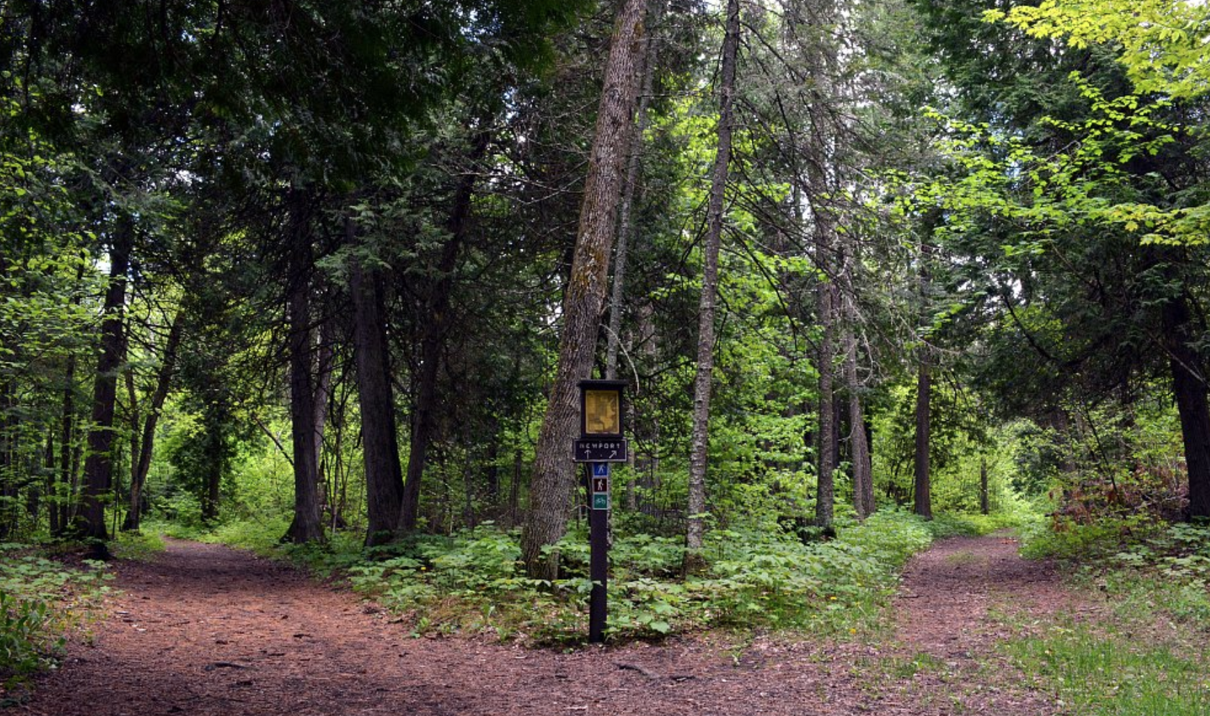
Solving problems by search

Slide 3
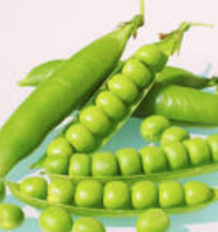
Review: PEAS model: on which most of AI agents work
PEAS: Performance measure, Environment states, Actuators, Sensors
P: a function the agent is maximizing (or minimizing)
E: A state = a group of variables
A: actions that the agent takes to move from one state to another according to a transition model
S: observations/sensors that allow the agent to infer the state

Slide 4

Maze problems
Initial
state
Initial state
Actions
Goal state
Objective function
Shortest path (a sum of step costs)
from the initial state to a goal state
Goal state

Slide 5


Example: Romania Traveling
On vacation in Romania; currently in Arad
Flight leaves tomorrow from Bucharest
The optimal solution is the shortest path from Arad to Bucharest
Initial state
Arad
Actions
Go from one city to another
Goal state
Bucharest
Objective function
Minimax the sum of edge costs (total distance traveled)

Slide 6
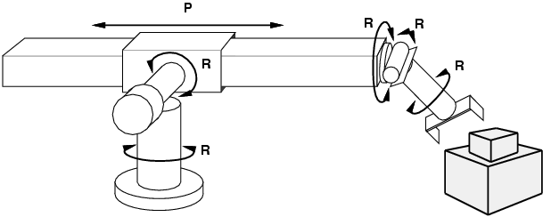
Example: Robot motion planning
States
Real-valued robot joint parameters (angles, displacements)
Actions
Continuous motions of robot joints
Goal state
Configuration in which object is grasped
Path cost
Time to execute, smoothness of path, etc.

Slide 7
State space
Given an AI problem, state space refers to all the states reachable from initial state
How large the state space can be?

Slide 8

Example: The 8-puzzle
3x3 board with 8 tiles. Each tile represents a number
A tile can only slide into the blank space .
States
Locations of tiles
8-puzzle: 181,440 states (9!/2)
15-puzzle: ~10 trillion states
24-puzzle: ~10²⁵ states
Actions
Move blank space left, right, up, down
Path cost
Each step costs 1.

Slide 9
What is Search?
Given:
Initial state
Goal state
Actions
Transition model
Path cost function
find a sequence of actions that minimize the cost
Can we use Dijkstra’s shortest path algorithm?
Cost of Dijkstra’s is O(E + V log V), where V is the size of the state space
Unaffordable cost because V may be huge!

Slide 10
Search: Basic idea
Begin at the initial state and expand it to all possible successor states
Maintain a frontier (a list of unexpanded states)
At each step, pick a state from the frontier to expand
Keep going until you reach a goal state
Goal: Try to expand as few states as possible

Slide 11
Search: Basic idea
start

Slide 12
Search: Basic idea

Slide 13
Search: Basic idea

Slide 14
Search: Basic idea

Slide 15
Search: Basic idea

Slide 16
Search: Basic idea

Slide 17
Search: Basic idea

Slide 18
Search: Basic idea

Slide 19
Search: Basic idea

Slide 20
Search: Basic idea

Slide 21
Search: Basic idea

Slide 22
Search: Basic idea

Slide 23
Search: Basic idea
All search algorithms share the basic idea above; they vary according to which state we will pick from the frontier to expand next (the so-called search strategy )

Slide 24
Pseudocode of All Search Algorithm
1. Initialize the frontier using the initial state
2. While the frontier != empty
Choose a frontier node according to search strategy and take it off the frontier
If the node is goal state, return solution
Else expand the node and add its successor states to the frontier

Slide 25
Visualization by Search tree
We can build a search tree for whole process, where each nodes represents a state
The root node is the initial state
The children of a node are the successor states of that node
A path corresponds to a sequence of actions
Goal: Find a path ending in the goal state
Starting state
Action
Successor state
…
Frontier
Goal state

Slide 26
Two ways to show a search process:
State Space Graphs vs. Search Trees
State Space Graph
Search Tree
S
Each NODE in search tree is a PATH in state space graph.
a
G
d
e
p
b
c
q
b
c
e
h
r
d
e
f
a
a
h
r
p
q
f
S
h
p
q
f
q
c
G
p
q
r
q
c
G
a
a

Slide 27

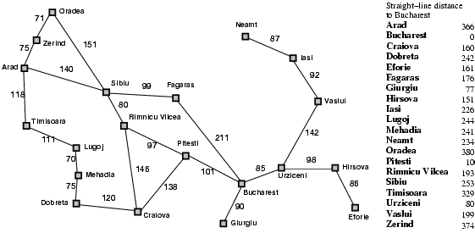
Tree search example (Romania)
Start: Arad
Goal: Bucharest

Slide 28

Tree search example
Start: Arad
Goal: Bucharest

Slide 29

Tree search example
Start: Arad
Goal: Bucharest

Slide 30

Tree search example
Start: Arad
Goal: Bucharest

Slide 31

Tree search example
Start: Arad
Goal: Bucharest

Slide 32

Tree search example
Start: Arad
Goal: Bucharest

Slide 33
Tree search example
Start: Arad
Goal: Bucharest
Notes:
This search tree is infinitely deep, contains redundant paths

Slide 34
Improve the search above by handling repeated states
In the example above, when we expand the node, we add all its successor states to the frontier
In order to eliminate repeated states:
Every time you expand a node, add that node to a explored set; do not add any explored states to the frontier again
Every time you add a node to the frontier, check if it already exists in the frontier with a higher path cost, and if yes, replace that node with the new one

Slide 35
Search without repeated states
Start: Arad
Goal: Bucharest

Slide 36
Search without repeated states
140
118
75
Start: Arad
Goal: Bucharest

Slide 37
Search without repeated states
118
75
280
239
291
220
Start: Arad
Goal: Bucharest

Slide 38
Search without repeated states
118
75
280
239
291
366
317
300
Start: Arad
Goal: Bucharest

Slide 39
Search without repeated states
118
75
280
291
338
450
366
317
300
Start: Arad
Goal: Bucharest

Slide 40
Search without repeated states
118
75
280
291
338
450
366
300
418
455
414
Start: Arad
Goal: Bucharest

Slide 41
Search without repeated states
118
75
280
291
338
450
366
300
418
455
414
Start: Arad
Goal: Bucharest

Slide 42
Analysis of search strategies
All the search algorithms we will learn follow the idea above.
In the following two lectures, we will examine search performance using the following criteria:
Completeness: does it always find a solution if one exists?
Optimality: does it always find a least-cost solution?
Time complexity: maximum number of nodes expanded
Space complexity: maximum number of nodes kept in memory
Time and space cost are measured in terms of
b: maximum branching factor of the search tree
d: depth of the optimal solution
m: the depth of the entire search tree

Slide 43
Lecture 7 Informed Search
CS 180 – Intelligent Systems
Dr. Victor Chen
Fall 2022

Slide 44

Informed Search

Slide 45
Informed (heuristic) Search
Idea: Use a heuristic function h(n) to rank nodes in the frontier and expand the node with the lowest h(n) value
Greedy search (Best-first search)
A* search

Slide 46
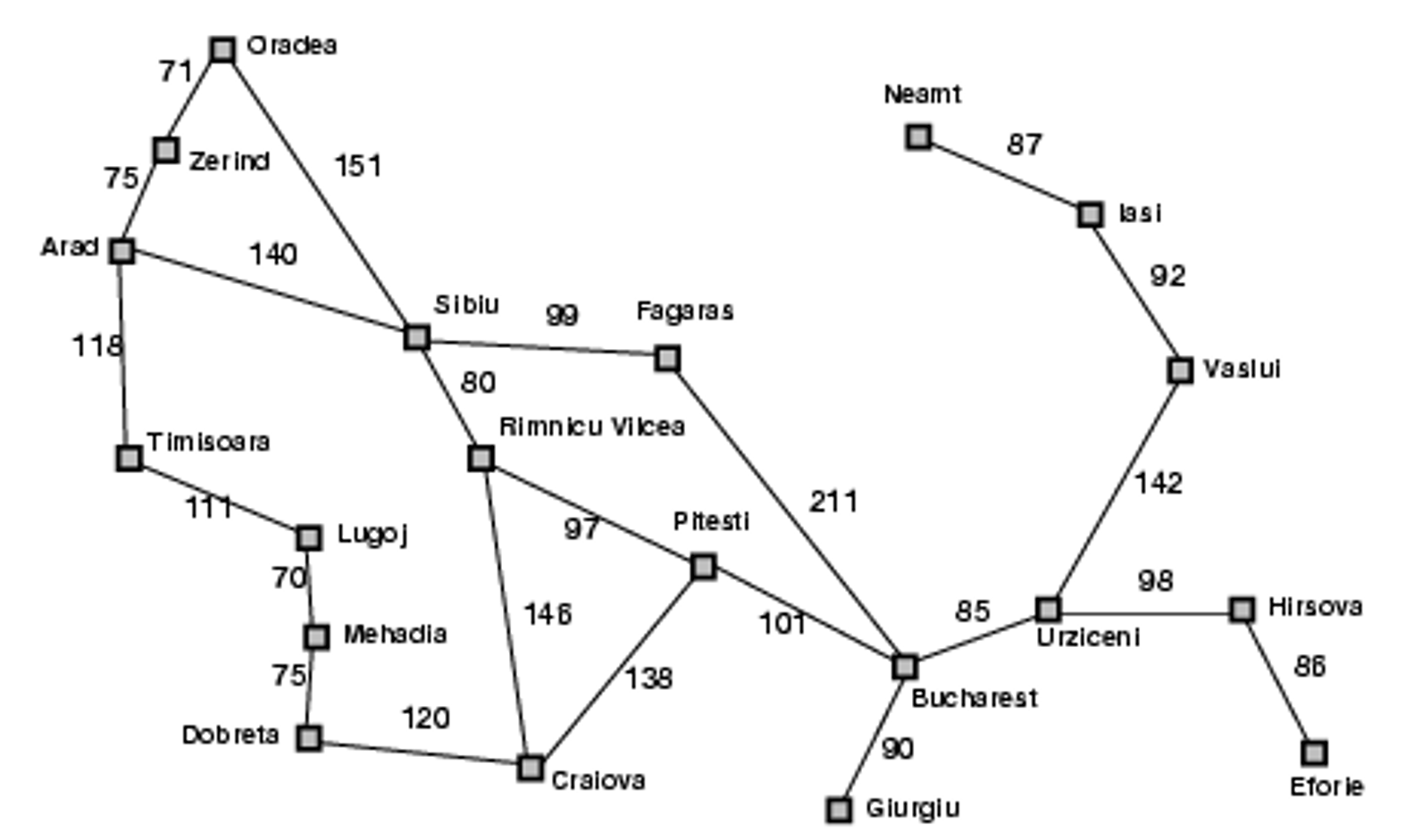
Heuristic for the Romania problem
heuristic function h(n)

Slide 47

Greedy best-first search example

Slide 48

Greedy best-first search example

Slide 49

Greedy best-first search example

Slide 50

Greedy best-first search example

Slide 51
Properties of greedy search
Complete?
No – can get stuck in loops.
start
goal

Slide 52
Properties of greedy best-first search
Complete?
No – can get stuck in loops
Optimal?
No

Slide 53
Properties of greedy best-first search
Complete?
No – can get stuck in loops
Optimal?
No
Time cost?
Worst case: O(b^{m}) where b is the branching factor and m is the maximum path length
Space cost?
Worst case: O(b^{m})

Slide 54
How can we fix the greedy search?
In the Romania traveling problem, greedy search only considers the remaining distance
Idea: Keep track of the distance already traveled in addition to the distance remaining.

Slide 55
A* search
Idea: Use evaluation function f(n) to estimate the path cost from start node to goal and expand the node with the lowest f(n) value
f(n) is to estimate path cost from start node to goal:
f(n) = g(n) + h(n)
g(n): cost from start node to node n
h(n): estimated cost from node n to goal (heuristic function)
Notes:
Dates back to 1968

Slide 56
A* search example (distance already traveled + distance remaining)

Slide 57
A* search example

Slide 58
A* search example

Slide 59
A* search example

Slide 60
A* search example

Slide 61
A* search example

Slide 62
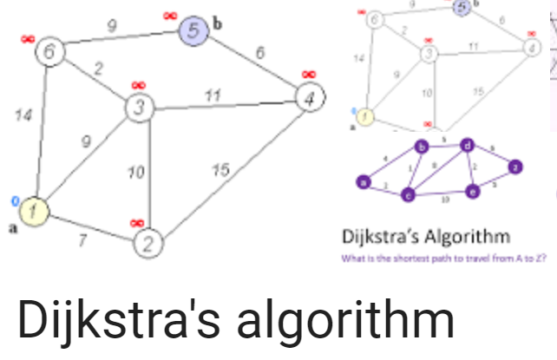
Dijkstra’s vs Greedy vs A*
Dijkstra’s algorithm order all the nodes on their g(n) values (distance already traveled).
Greedy algorithm order all the nodes on their h(n) values (distance remaining).
A* balances Dijkstra’s algorithm with greedy search by ordering all the nodes using f(n) = g(n) + h(n), which is the estimated path cost from start node through n to goal.

Slide 63

Dijkstra's vs. A* search
Source: Wikipedia

Slide 64
Is A* optimal?
Is A* is guaranteed to provide the shortest path?
Theorem: If h(n) is admissible, then A* is optimal

Slide 65
Admissible heuristic
A heuristic h(n) is admissible if for every node n, h(n) ≤ h*(n), where h(n) is the estimated cost from n to goal while h*(n) is the true cost from n to goal.
Is the distance heuristic we used before in Romanian traveling problem is admissible?
Yes. Because straight line distance never overestimates the actual road distance.

Slide 66
How to tell which heuristic is better?
If h₁ and h₂ are both admissible heuristics and h₂(n) ≥ h₁(n) for all n, then h₂ dominates h₁
Using h₂(n) will lead to expanding fewer nodes than h₁(n) .

Slide 67
Properties of A*
Complete?
Yes – Will always find a solution if one exists
Optimal?
Yes If h(n) is admissible
Time/space cost?
A* search expands every node with h(n) ≤ C*- g(n)
C* is the path cost of the optimal solution
g(n): cost from start node to node n
A higher (dominating) h(n) will have a higher pruning power

Slide 68
Search strategies
Algorithm | Complete? | Optimal? | Time complexity | Space complexity
Greedy
A*
Worst case: O(b^{m})
where b is branching factor
and m is maximum path length
No
No
Yes (if heuristic is
admissible)
Number of nodes with h(n) ≤ C*- g(n)
h(n): estimated cost from n to goal
g(n): cost from start node to n
C* is the path cost of the optimal solution
Yes

Slide 69
Lecture 8 Uninformed search
CS 180 – Intelligent Systems
Dr. Victor Chen
Fall 2022

Slide 70

Uninformed Search

Slide 71
Uninformed search
In uninformed search, we use only the information available in the problem definition
Breadth-first search
Depth-first search
Iterative deepening search
Uniform-cost search

Slide 72
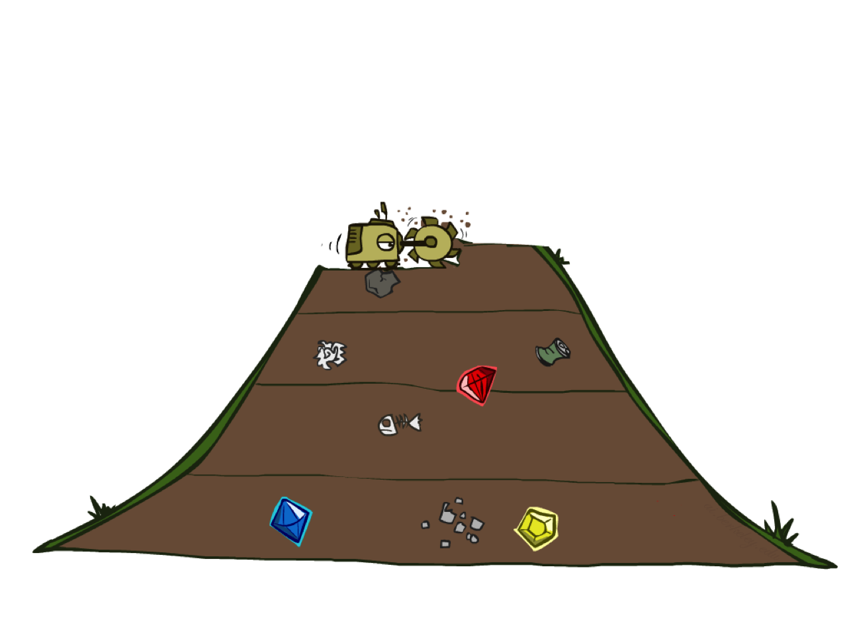
Breadth-First Search

Slide 73
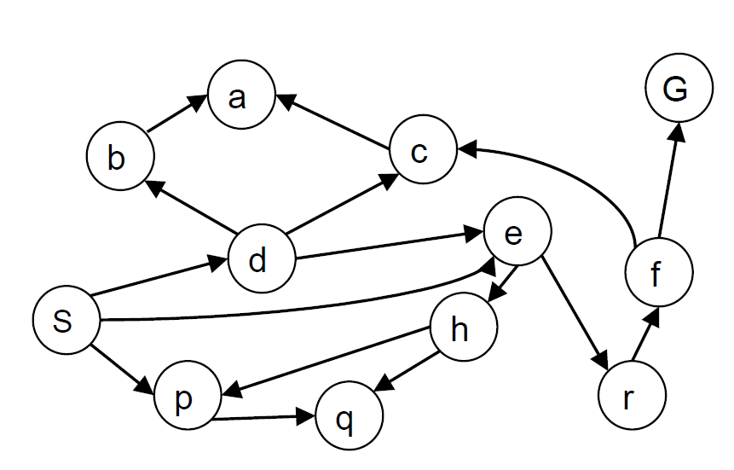
Breadth-First Search
Expand shallowest unexpanded node
Basic idea: visit all your neighbors before your neighbor's neighbors
Implementation: frontier is a FIFO queue
State space graph for a search problem

Slide 74
Breadth-First Search
Strategy: expand a shallowest node first
Implementation: Frontier is a FIFO queue
a
G
b
c
State space graph
d
e
f
S
h
p
q
r
S
d
e
p
Search
Tiers
b
c
e
h
r
q
Search tree
a
a
h
r
p
q
f
p
q
f
q
c
G
q
c
G
a
a

Slide 75
Breadth-First Search (BFS) Cost
What nodes does BFS expand?
Expand all nodes above shallowest solution
Let depth of shallowest solution be d
Search takes time O(b^{d}), where b is maximum branching factor of the search tree
How much space does the frontier take?
Has roughly the last tier, so O(b^{d})
1 node
b
…
b nodes
d tiers
b² nodes
b^{d} nodes
b^{m} nodes

Slide 76
Properties of breadth-first search
Complete?
If a solution exists, BFS will find it. So yes!
Optimal?
Yes, only if costs are all 1
Time cost?
O(b^{d})
(b: maximum branching factor and d is the depth of the optimal solution)
Space cost?
O(b^{d})

Slide 77
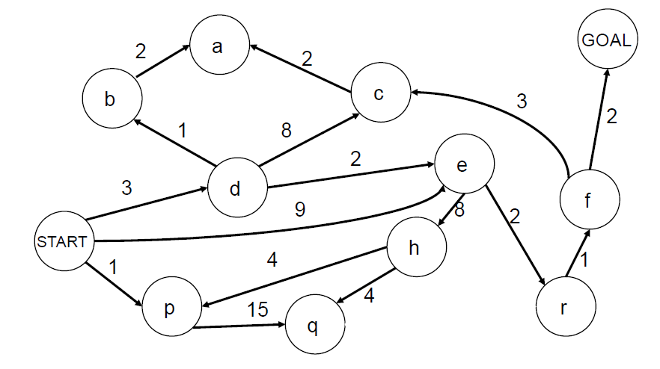
BFS optimal? Yes but only if cost = 1 per step
BFS finds the solution with the fewest steps, but does not always find the shortest path (optimal solution)

Slide 78

Depth-first search

Slide 79
Depth-first search
Expand deepest unexpanded node
Basic idea: visit nodes adjacent to the last visited node first
Implementation: frontier is a LIFO queue (a stack)

Slide 80
Depth-First Search
Strategy: expand a deepest node first
Implementation: Frontier is a LIFO stack
a
G
a
c
b
c
b
e
d
e
d
f
f
S
h
h
p
p
r
q
r
q
S
d
e
p
b
c
e
h
r
q
a
a
h
r
p
q
f
p
q
f
q
c
G
q
c
G
a
a

Slide 81
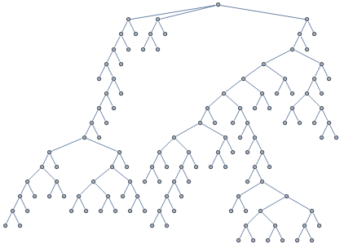
BFS vs. DFS

Slide 82
BFS vs. DFS

Slide 83
BFS vs. DFS

Slide 84
BFS vs. DFS

Slide 85
BFS vs. DFS

Slide 86
BFS vs. DFS

Slide 87
BFS vs. DFS

Slide 88
BFS vs. DFS

Slide 89
BFS vs. DFS

Slide 90
BFS vs. DFS

Slide 91
BFS vs. DFS

Slide 92
BFS vs. DFS

Slide 93
BFS vs. DFS

Slide 94
BFS vs. DFS

Slide 95
BFS vs. DFS

Slide 96
BFS vs. DFS

Slide 97
BFS vs. DFS

Slide 98
BFS vs. DFS

Slide 99
BFS vs. DFS

Slide 100
BFS vs. DFS

Slide 101
BFS vs. DFS

Slide 102
BFS vs. DFS

Slide 103
Properties of depth-first search
Complete?
Fails in infinite-depth tree, or states with loops
Optimal?
No – returns the first solution it finds
Time cost?
Worst case: O(b^{m}) (b: maximum branching factor and m is the depth of entire search tree)
Comparison with BFS:
O(b^{d}) (d is the depth of the optimal solution)
Terrible since m >> d!
But if there are lots of solutions, DFS may be much faster than BFS
Space cost?
O(bm), i.e., linear cost!

Slide 104

Demo Maze BFS

Slide 105
Demo Maze DFS

Slide 106
Can we have a search strategy that is optimal like BFS and also efficient like DFS?

Slide 107
Iterative deepening search (IDS)
Use DFS as a subroutine
Check the root
Do a DFS search for a solution of length 1
If there is no solution of length 1, do a DFS search for a solution of length 2
If there is no solution of length 2, do a DFS search for a solution of length 3…

Slide 108
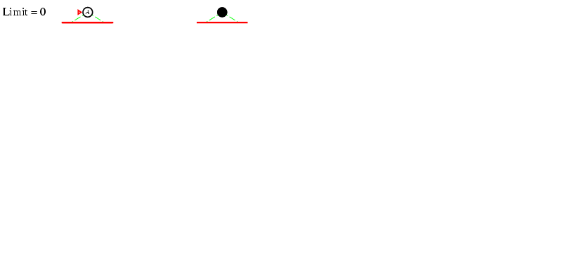
Iterative deepening search

Slide 109
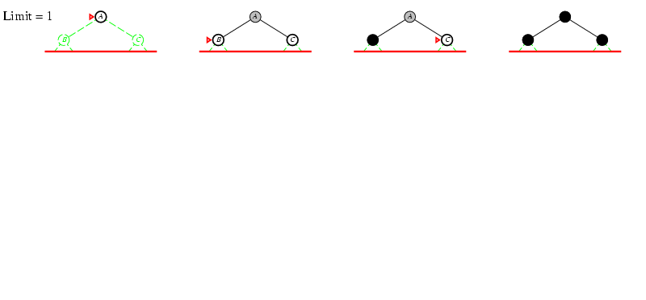
Iterative deepening search

Slide 110
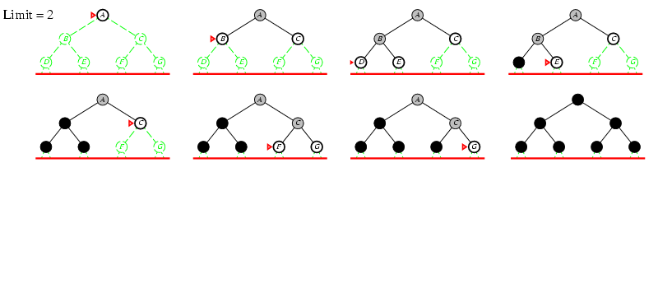
Iterative deepening search

Slide 111
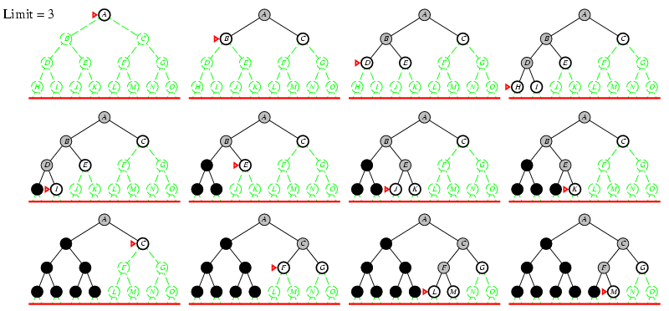
Iterative deepening search

Slide 112
Properties of iterative deepening search
Complete?
Yes
Optimal?
Yes, if step cost = 1
Time cost?
O(b^{d}) (d is the depth of the optimal solution)
Like BFS
Space cost?
O(bd)
Linear cost (even better than DFS)

Slide 113

Uniform Cost Search

Slide 114
Uniform-cost search
Rank all the nodes on g(n), the cost from initial state to n, and expand the node with the lowest g(n)
Implementation: frontier is a priority queue ordered by g(n)

Slide 115
Uniform-cost search example
2
G
Strategy: expand a cheapest node first:
Frontier is a priority queue (priority: g-value (cumulative cost))
a
b
1
8
c
2
2
3
d
e
f
9
8
2
S
h
1
1
p
q
r
15
0
S
d
3
e
9
p
1
b
4
e
5
h
17
r
11
q
16
c
11
a
6
a
h
13
r
7
p
q
f
p
q
f
8
q
c
G
q
c
a
11
G
10
a

Slide 116
UCS vs BFS
BFS is a special case of UCS when all step costs are equal

Slide 117
UCS == Dijkstra's algorithm
UCS is equivalent to Dijkstra's algorithm except that Dijkstra's algorithm is used to find shortest paths from initial node to every other nodes in a graph, whereas UCS is only used to find the shortest path from initial node to a goal node.

Slide 118
Uniform Cost Search (UCS) Properties
Is it complete?
Yes!
Is it optimal?
Yes!
Time and space cost?
Expand all nodes with cost less than optimal solution (g(n) ≤ C*)

Slide 119
Pros and cons of uniform cost search
The good: UCS is complete and optimal!
The bad:
Explores nodes in every “direction”
Expensive

Slide 120
Uniform-cost search

Slide 121
Review: Uninformed search strategies
Algorithm | Complete? | Optimal? | Time complexity | Space complexity
BFS
DFS
IDS
UCS
Yes
If all step costs are equal
O(b^{d})
O(b^{d})
No
No
O(b^{m})
O(bm)
Yes
If all step costs are equal
O(b^{d})
O(bd)
Yes
Yes
Number of nodes with g(n) ≤ C*
b: maximum branching factor of the search tree
d: depth of the optimal solution
m: maximum length of any path in the search tree
C*: cost of optimal solution
g(n): cost of path from initial state to node n

Slide 122
How to choose between uninformed search strategies
Uniform Cost Search will reach the goal in the cheapest way possible.
Breadth-First Search will reach the goal in the shortest way possible.
Depth-First Search is not optimal but it may run much faster when multiple solutions exists.
Iterative deepening search (IDS) mixed BFS with DFS

Slide 123
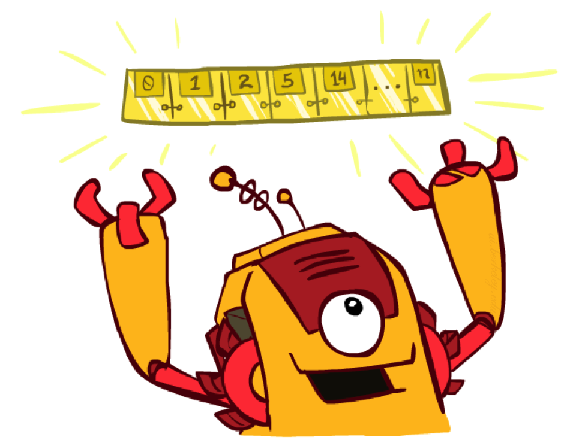
The One Queue for All Strategies
All search algorithms are the same except for frontier strategies
Conceptually, all frontiers are priority queues.
Practically, for DFS and BFS, you can avoid the overhead from an priority queue by using stacks and queues

Slide 124
Recap: All search strategies so far…
Algorithm | Complete? | Optimal? | Time complexity | Space complexity
BFS
DFS
IDS
UCS
Greedy
A*
Yes
If all step costs are equal
O(b^{d})
O(b^{d})
No
No
O(b^{m})
O(bm)
Yes
If all step costs are equal
O(b^{d})
O(bd)
Yes
Yes
Number of nodes with g(n) ≤ C*
Worst case: O(b^{m})
No
No
Best case: O(bd)
Yes (if heuristic is
admissible)
Yes
Number of nodes with g(n)+h(n) ≤ C*

Slide 125
More demos
http://qiao.github.io/PathFinding.js/visual/
http://bryukh.com/labyrinth-algorithms/

Slide 126
Lecture 9 Games and Adversarial Search
CS 180 – Intelligent Systems
Dr. Victor Chen
Fall 2022

Slide 127

Games and adversarial search

Slide 128
Fully observable vs. partially observable
Fully observable: The values of all the state variables are known to the agent

Slide 129
Deterministic vs. stochastic
Deterministic: The next state is completely determined by the current state and the action being taken.
Otherwise, stochastic (outcomes are controlled by chance)

Slide 130
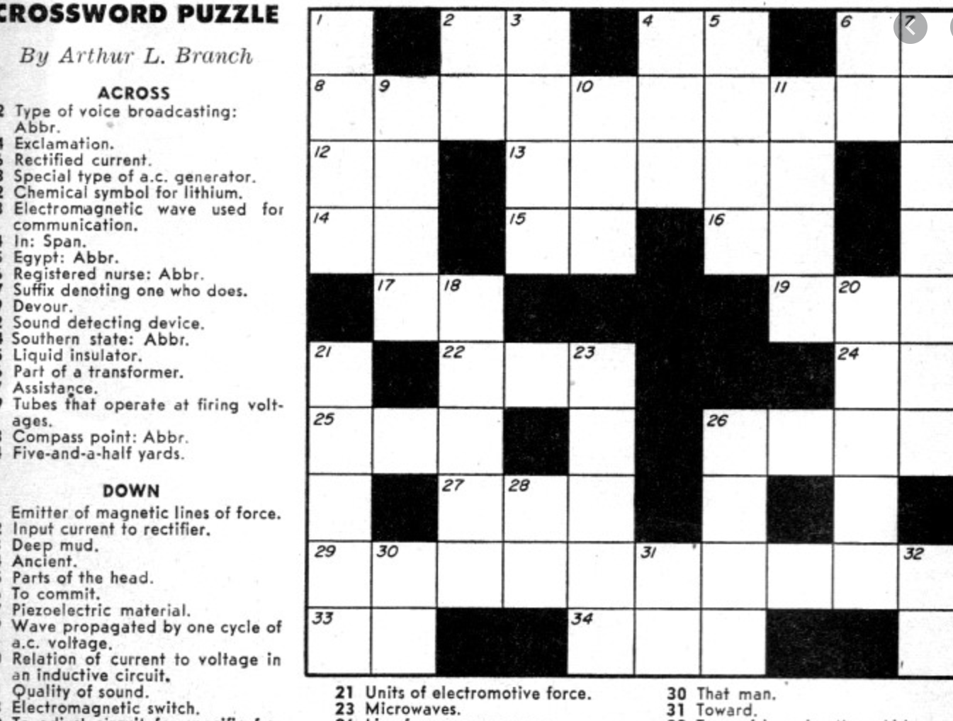
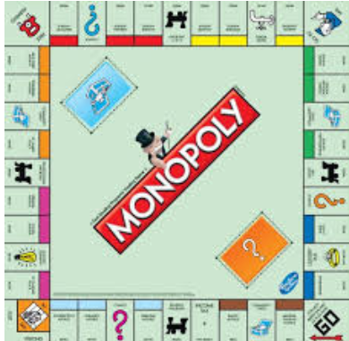

Types of game environments
Fully observable: The values of all the state variables are known to the agent
Deterministic: The next state is completely determined by the current state and the action being taken.
 | Deterministic | Stochastic
Perfect information (fully observable)
Imperfect information (partially observable)
Chess, checkers, go
Monopoly
Crossword puzzle
Scrabble, poker, bridge
Crossword puzzle
Monopoly
Bridge
Notes:
Backgammon, monopoly, because dice

Slide 131
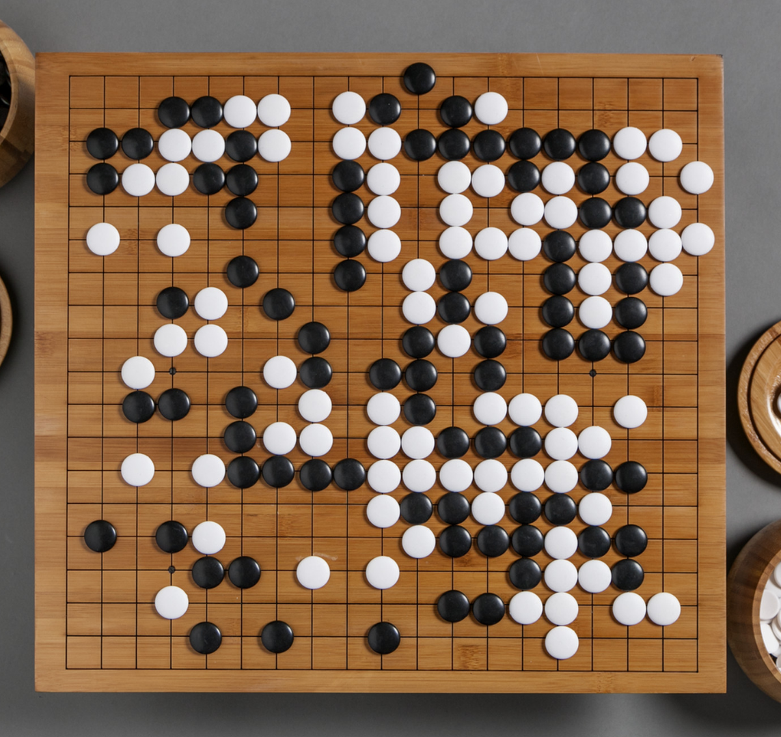
Our focus
In CSC180, we mainly focus on deterministic, fully observable, zero-sum games.
Go, chess, checkers

Slide 132
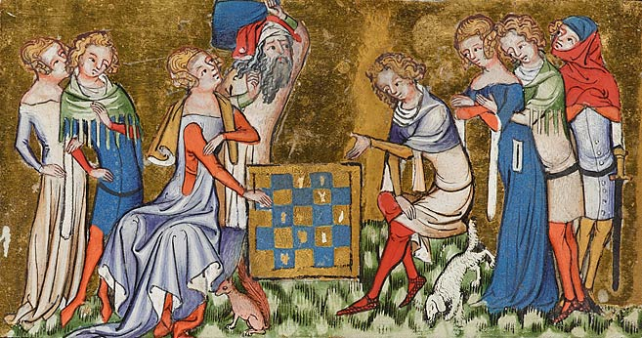
Zero-sum games
The sum of the amounts some players win equals the losses of the others.
Go, chess, checkers, poker and gambling are zero-sum games

Slide 133

Build a game-playing AI agent…
Our goal: to look for such a policy that given a state, tells us what is best action/move in that state to maximize reward?

Slide 134
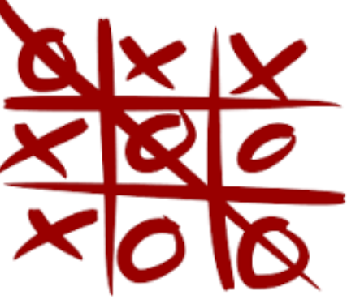
Take Tic-tac-toe as example
Tic-tac-toe: Two players take turns marking the spaces in a 3×3 grid. The player who places three same marks in a horizontal, vertical, or diagonal row wins the game

Slide 135
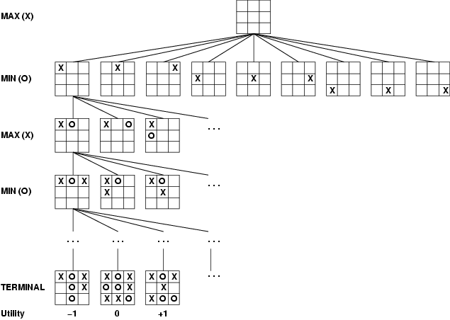
Game tree of tic-tac-toe
A game of tic-tac-toe between two players, “max” and “min”
Even a simple game like tic-tac-toe is too complex for us to draw the entire game tree !

Slide 136
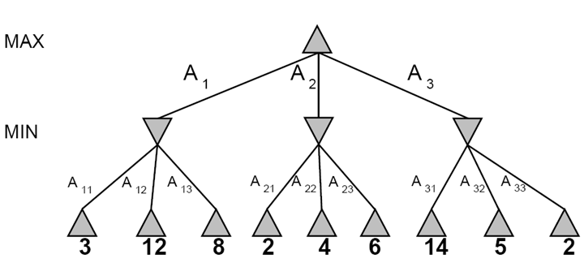
A abstract game tree for a trivial game
This is a zero-sum game
One player (MAX) maximizes result
The other (MIN) minimizes result
A game where two players (MAX and MIN) take turns.
are MAX nodes, in which it is MAX’s turn to move
are MIN nodes, in which it is MIN’s turn to move
Numbers on the leaf nodes (terminal states) are the reward MAX wins!

Slide 137
Smart search to win? Minimax search
Minimax search:
Compute each node’s minimax value:
Minimax value: The highest reward value MAX can achieve if MAX plays against an optimal adversary
Best move for MAX in a state is its successor state with the highest minimax value

Slide 138
Adversarial Search (Minimax search)
Minimax values: computed recursively
5
max
2
5
min
8
2
5
6
Reward (terminal) values

Slide 139
Derive Minimax values
def minimax_value(state):
if the state is a terminal state: return the state’s reward
if player = MAX: return max-value(state)
if player = MIN: return min-value(state)
def max-value(state):
initialize v = -∞
for each successor of state:
v = max(v, value(successor))
return v
def min-value(state):
initialize v = +∞
for each successor of state:
v = min(v, value(successor))
return v

Slide 140
Minimax Example
Minimax decision made for MAX
3
3
2
2
3
12
8
2
4
6
14
5
2
Each layer of the search tree is called a ply.

Slide 141
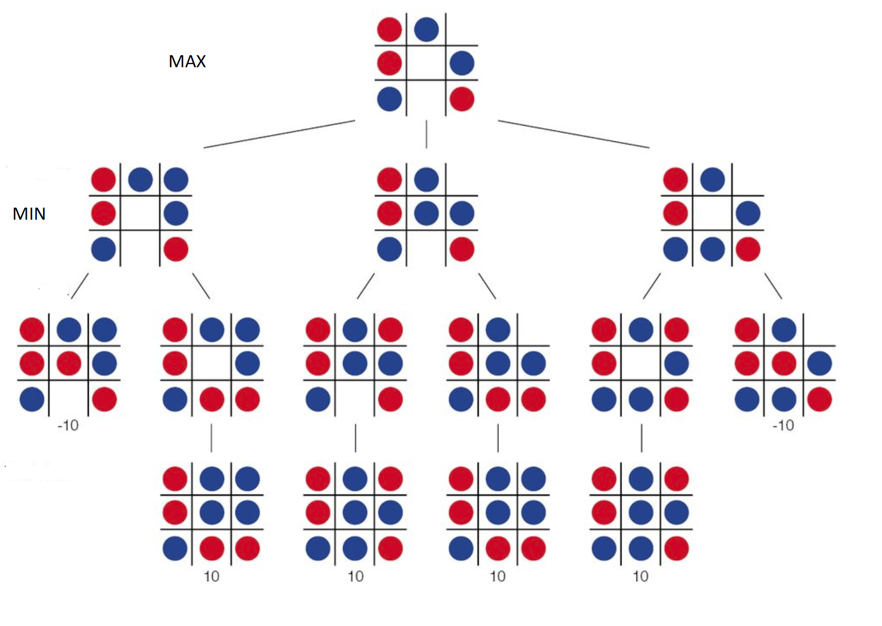
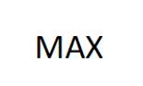
You are MAX in blue (tic-tac-toe)…

Slide 142
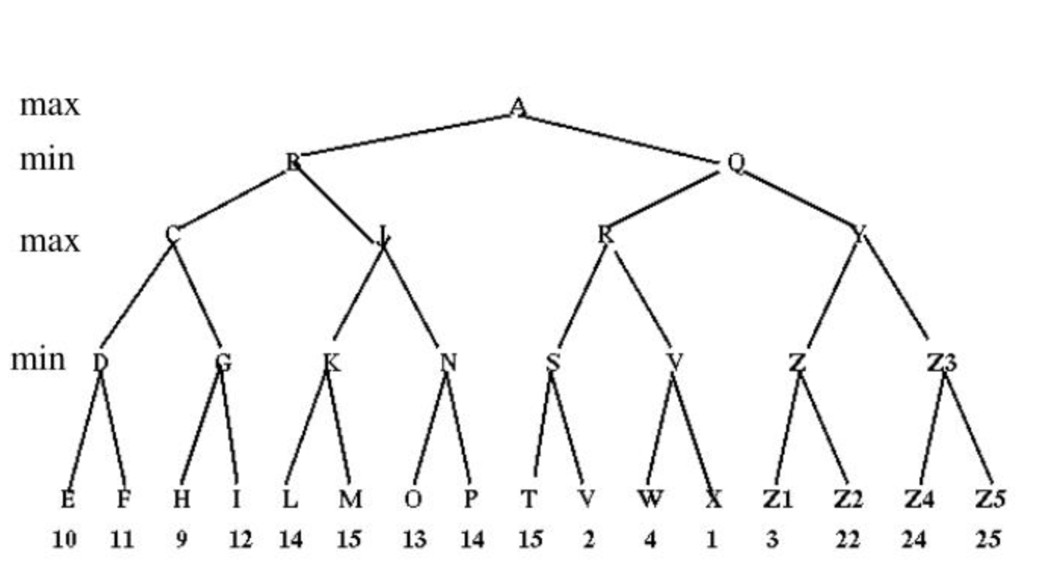
Practice
You play as MAX and you are at A now. Which state you should move to next?

Slide 143
Optimality of minimax
The minimax search is the optimal policy against an optimal adversary
If your adversary is suboptimal, your reward (utility) value can only be higher than if you were playing against an optimal adversary!

Slide 144
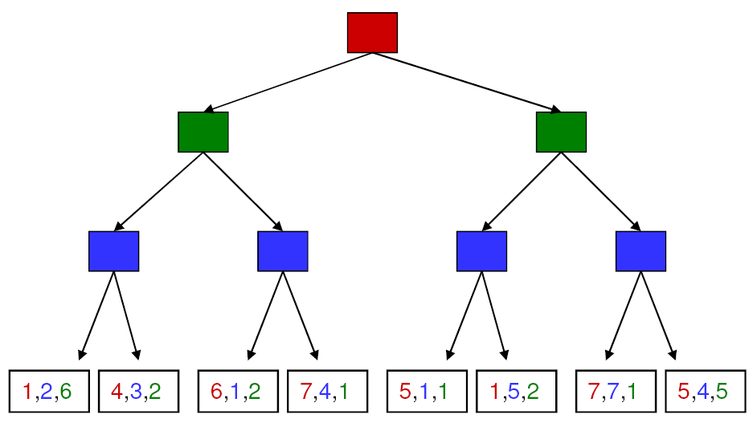
More than two players, non-zero-sum?
4,3,2
4,3,2
1,5,2
4,3,2
7,4,1
1,5,2
7,7,1
Minimax values become vector rather than scalar value
Each player maximizes her own reward at her node (assuming no alliances)

Slide 145
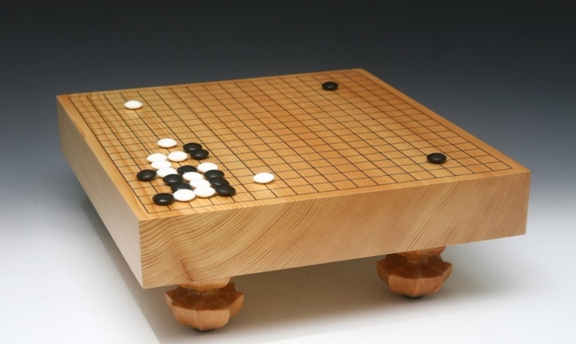
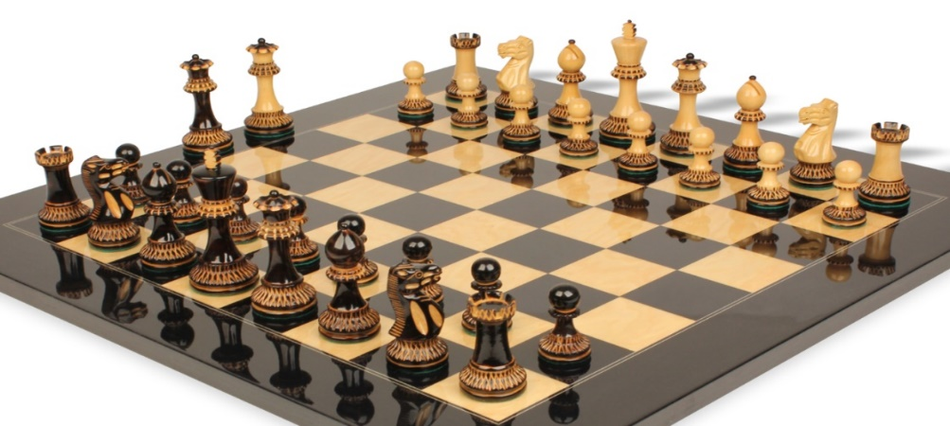
Minimax efficiency: Naïve DFS does not work
How efficient is minimax search?
Perform a complete DFS of the game tree. If tree depth is m and branching factor is b
Time: O(b^{m})
Space: O(bm)
Example: For chess, b ≈ 35, m ≈ 100
 | Board Size | Branching Factor (b)
Go | 19*19=361 | ≈250
Chess | 8*8=64 | ≈35

Slide 146

Minimax Efficiency
How to improve it?
Do we need to explore/search the whole tree?
No. We use tree pruning

Slide 147
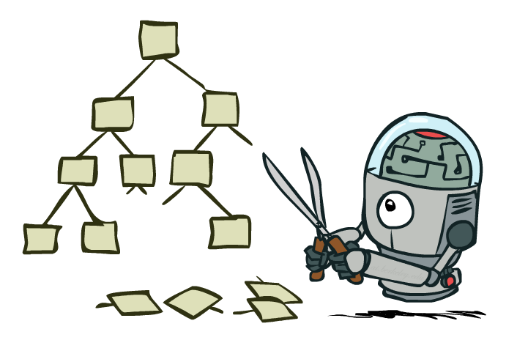
Game Tree Pruning

Slide 148
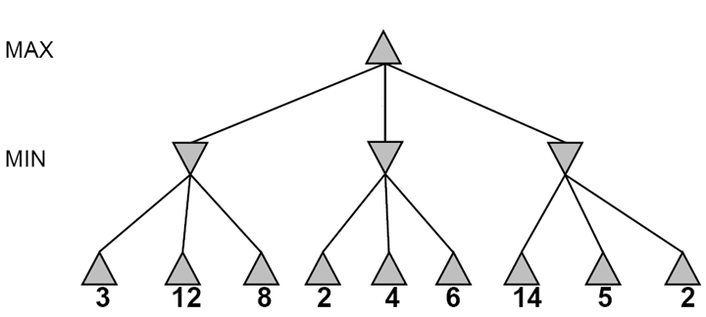
Alpha-beta pruning
Compute the minimax value of a node without expanding every nodes under each child of the current node

Slide 149
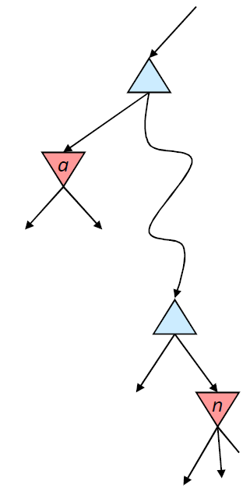
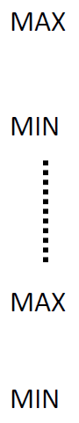
Alpha-beta pruning for MAX player
Suppose we are working at node n
Suppose α is the current best-choice value for MAX
As we loop over n ’s children, the value at node n decreases
If it drops below α, MAX will never choose n , so we can ignore n’s remaining children
α is a better choice than n
Analogously, β is the current best-choice value for MIN player
We want to estimate the minimax for this node.

Slide 150
Alpha-beta pruning
≥3
3

Slide 151
Alpha-beta pruning
≥3
Worse than 3! Pruning!
3
≤2

Slide 152
Alpha-beta pruning
≥3
3
≤2
≤14

Slide 153
Alpha-beta pruning
≥3
3
≤2
≤5

Slide 154
Alpha-beta pruning
3
3
≤2
2
Notes:
Could we have done better with the right branch?

Slide 155
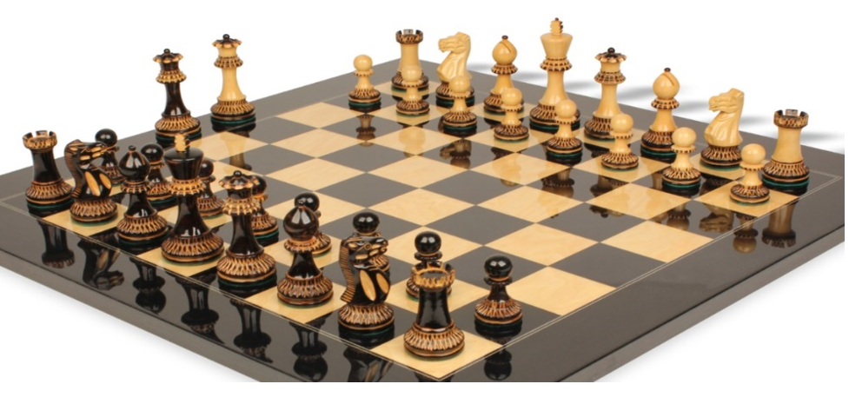
Alpha-beta search
Alpha-beta search
updates the values of α, β as the search goes
and prune the nodes whose values are worse than the current α or β value (current best choice) for MAX or MIN, respectively.
In chess, the branching is about 35. Alpha Beta search can reduce it to about 6 and therefore enables a 10 ply search on a regular PC.

Slide 156
Alpha-beta demo
http://homepage.ufp.pt/jtorres/ensino/ia/alfabeta.html

Slide 157
Reflection on Alpha-Beta search
Alpha-Beta pruning has no effect on the minimax value for the tree root node. However, the value at intermediate nodes may not be the exact minimax values. How to solve this?
Answer: We run alpha beta pruning for each child of the current node and then choose the action that moves to the successor with the maximum minimax value.
Good child ordering improves effectiveness of pruning.
With “perfect ordering”: Time complexity drops to O(bm/2).

Slide 158
Alpha-beta pruning with child ordering
≥3
Worse than 3! Pruning!
3
≤2

Slide 159

Alpha-beta pruning with child ordering
≥3
Worse than 3! Pruning!
3
≤2
≤2

Slide 160
Alpha-Beta search on deep tree game
Alpha beta pruning works only for small problems (shallow tree).
How can we apply alpha beta pruning to solve large problems?
Basic idea: We cut the tree at a certain depth to limit the search for a tradeoff between computation cost and decision optimality.
Approach: limited-depth alpha-beta search with heuristic function.

Slide 161
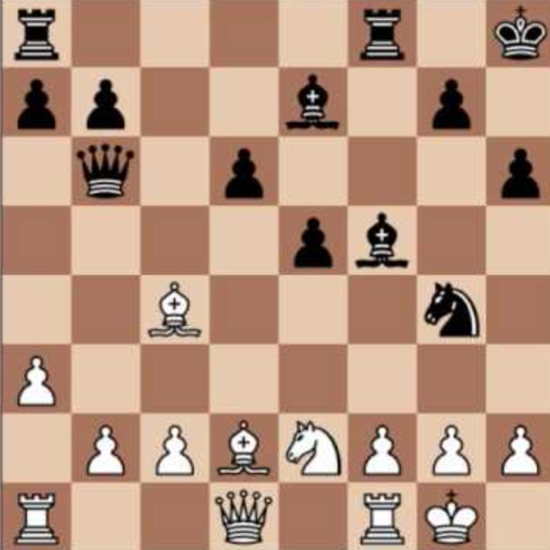
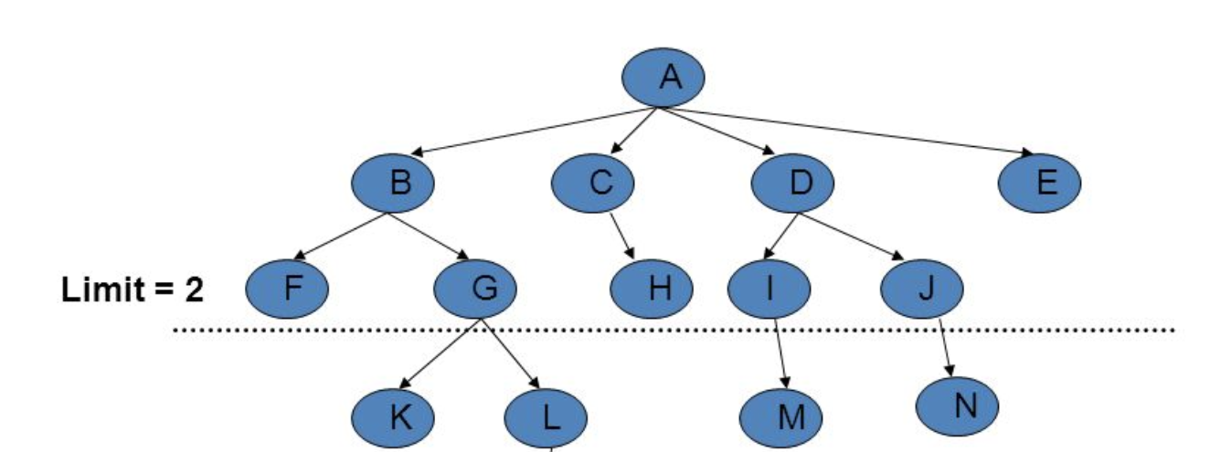

Limited-depth search with heuristic function
Step 1: We cut off the game tree at a certain depth, d, called a d-ply search.
Step 2: For any non-terminal states at the depth d, we apply some heuristic function to estimate the success likelihood (e.g., minimax value, the probability to win) of those states.
Step 3: Apply alpha-beta pruning in the d-ply search
What would be a good heuristic to estimate the success likelihood of a non-terminal states for chess?

Slide 162
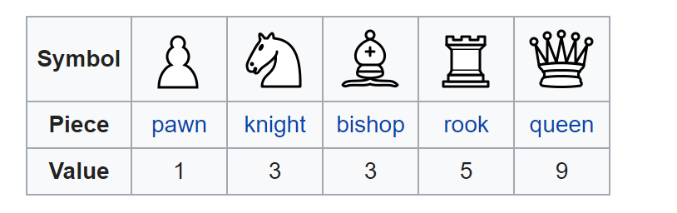
Heuristic function
A heuristic function could be as simple as a weighted sum of some features.
h(s) = w₁ f₁(s) + w₂ f₂(s) + … + w_{n} f_{n}(s)
Each feature:
f_{k}(s) is the advantage in terms of a piece, e.g., f₁(s) = (number of white queens)−(number of black queens)
w_{k} is the relative value of a piece (pawn = 1, knight = 3, rook = 5, queen = 9).

Slide 163
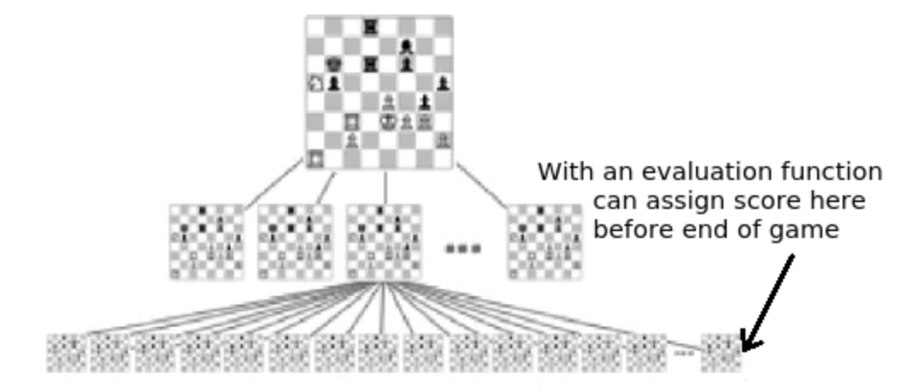
Limited-depth search with heuristic function

Slide 164
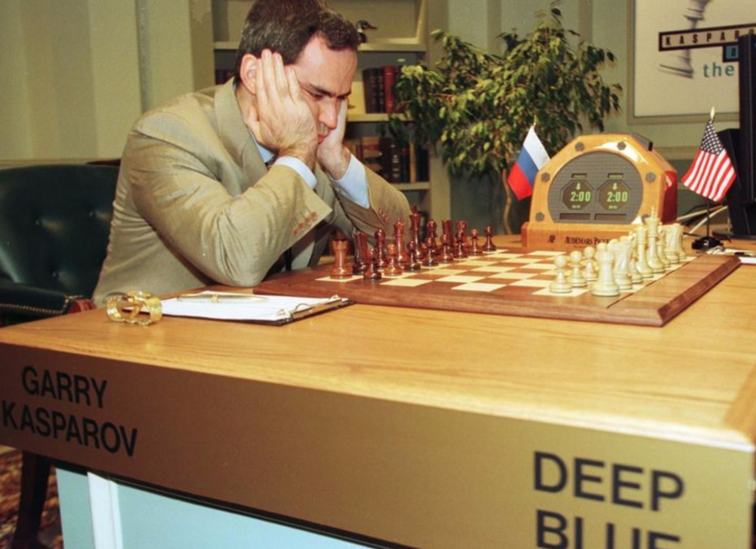
Limited-depth search with heuristic function
Deep Blue was a chess-playing agent developed by IBM.
Mainly based on limited-depth alpha-beta search with heuristic function.
Searches 200 million states per second, uses very sophisticated heuristic function, and performs search up to 40 ply.
Deep Blue beat human world champion Gary Kasparov in a six-game match in 1997.

Slide 165
Minimax alpha-beta pruning implementation

Slide 166
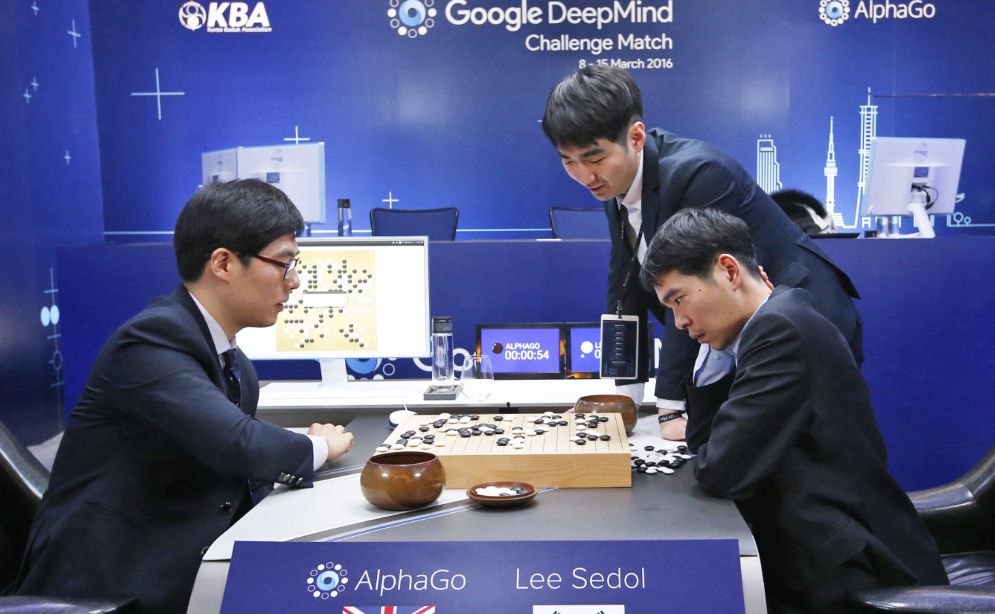
Beyond minimax search
Most game-playing AIs (Deep Blue) in the past are based on game tree search we learned in this lecture.
However, today’s game AIs (e.g., AlphaGo) rely less on tree search and more on knowledge (machine learning).

Slide 167
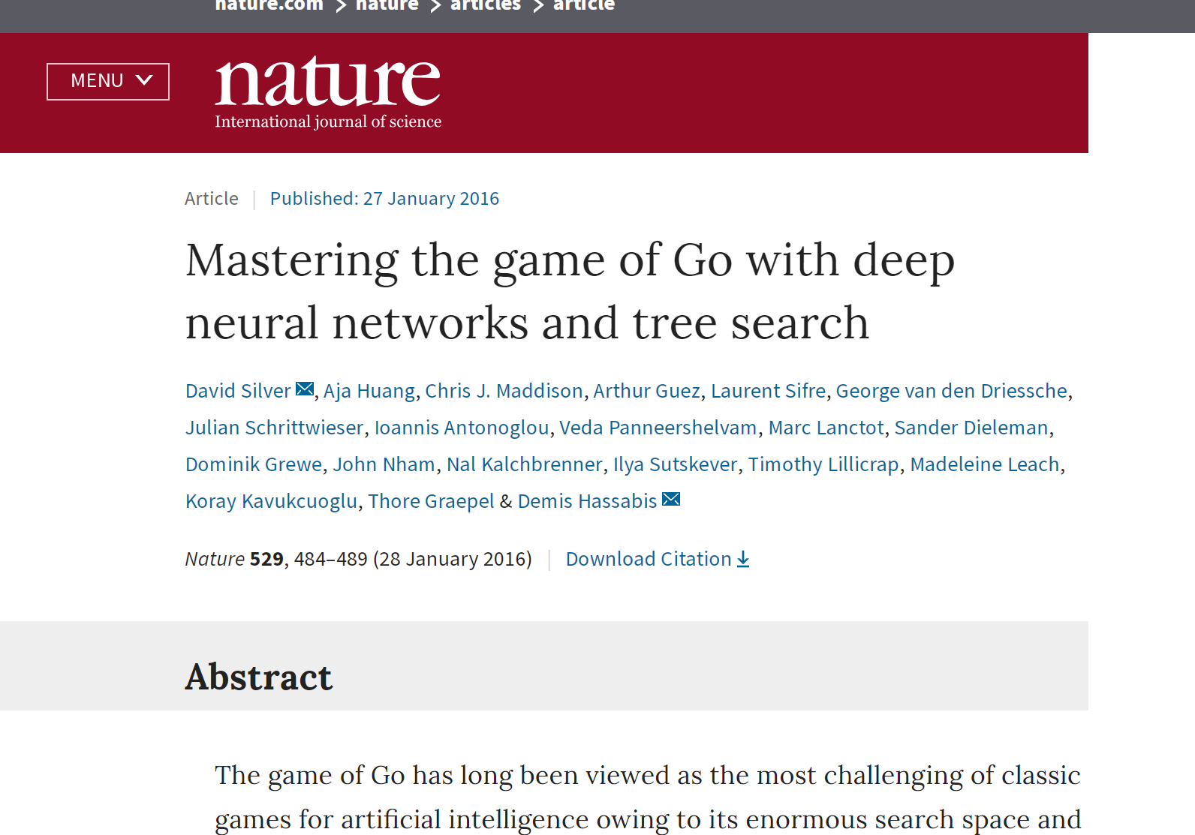
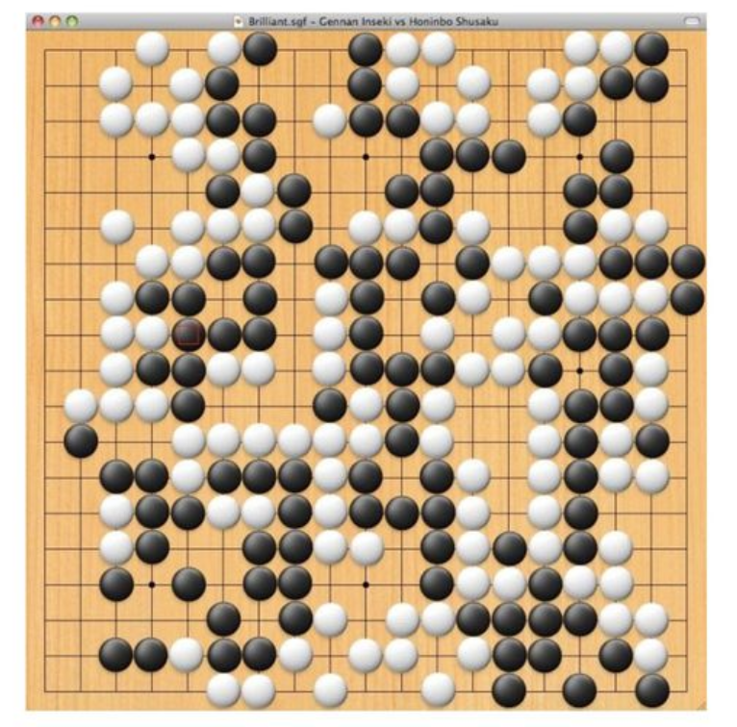
AlphaGo (an AI from Google)

Slide 168
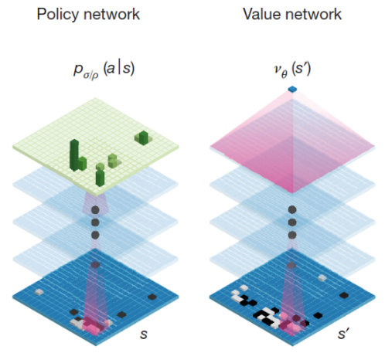
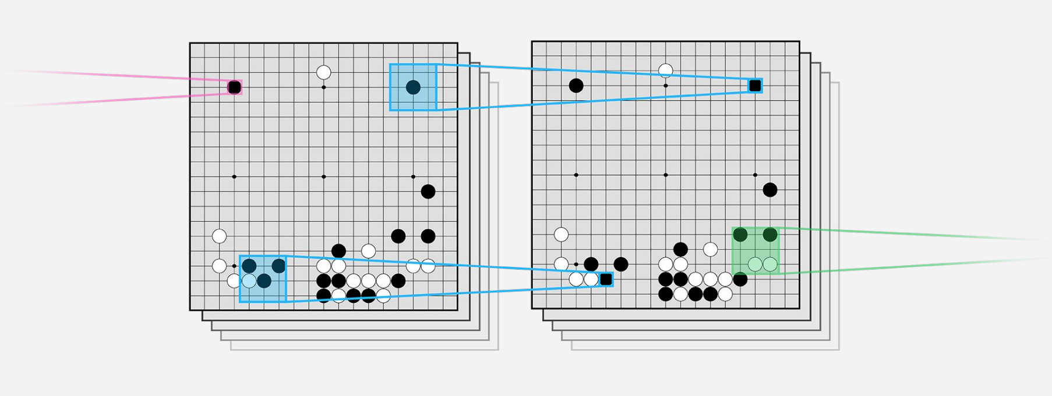
AlphaGo
Treat the Go board as an image

Slide 169
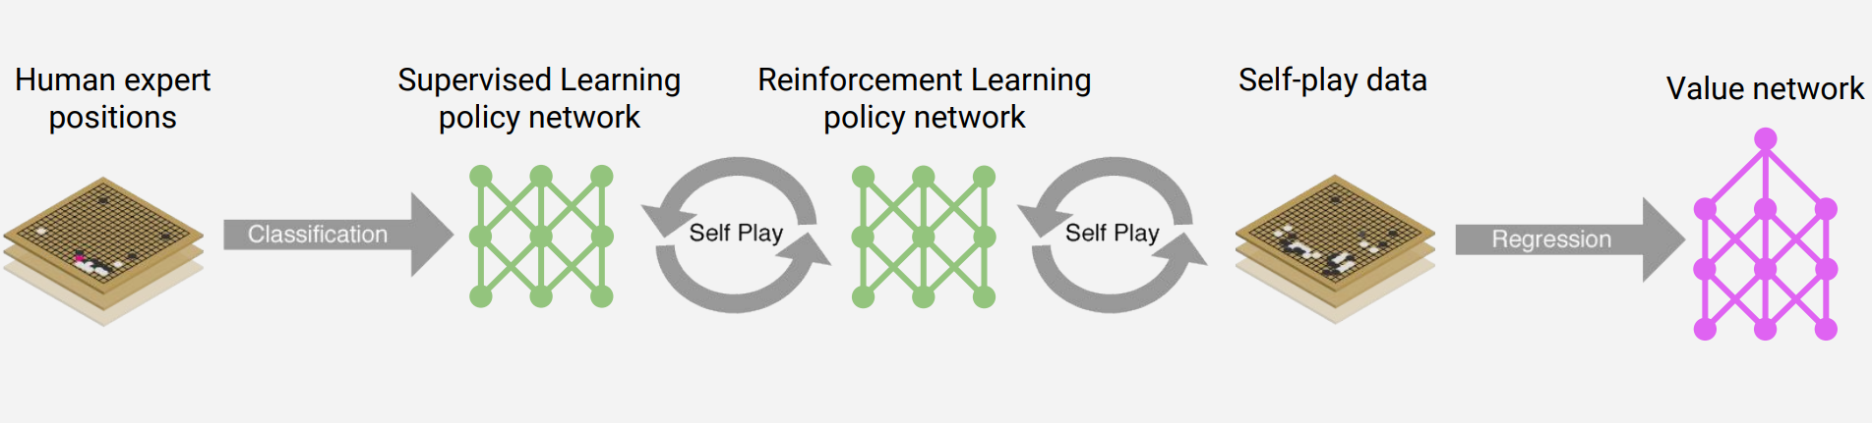
AlphaGo
Policy network (CNN) was trained to predict human moves
Value network (CNN) was trained to predict reward of each state.

Slide 170
AlphaGo uses two policy networks
SL policy network (CNN)
Given state s, predict probabilities of human moves
Trained on 30M positions (states) from human experts, 57% accuracy on predicting human moves
12 layer-CNN
4 weeks on 50 GPUs using Google Cloud
RL policy network (CNN)
Two CNN networks play against each other and update parameters.
Machine plays against itself (self-play)
12 layer-CNN
1 week on 50 GPUs using Google Cloud

Slide 171
AlphaGo uses one value network
Value network (CNN)
Given any state s, predict the reward of that state
This is a regression network use stochastic gradient descent (SGD) to minimize mean squared error (MSR) between actual rewards (based on self-play) and predicted rewards
12 layer CNN
Trained on 30M self-play positions (states)
1 week on 50 GPUs using Google Cloud

Slide 172
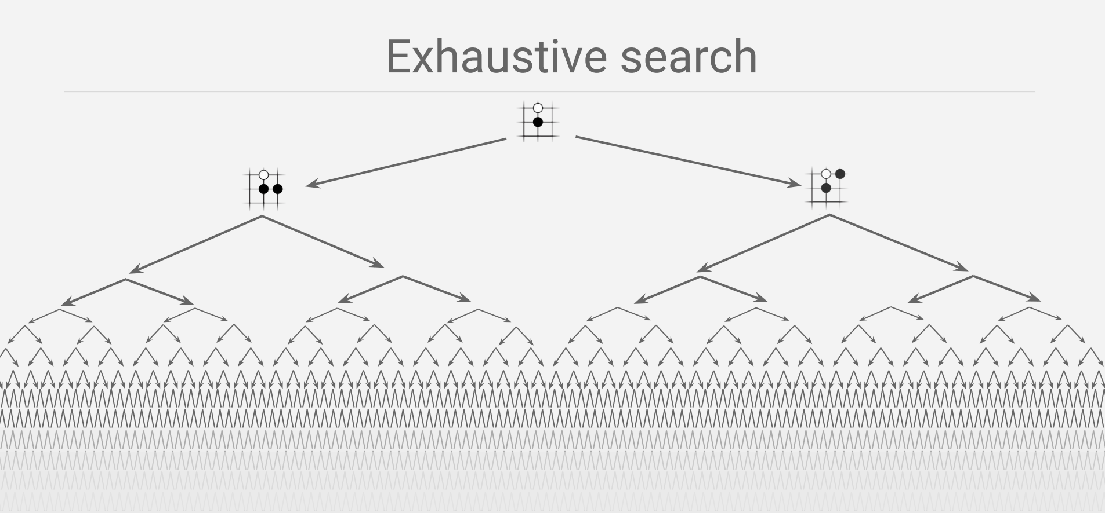
Tree pruning

Slide 173
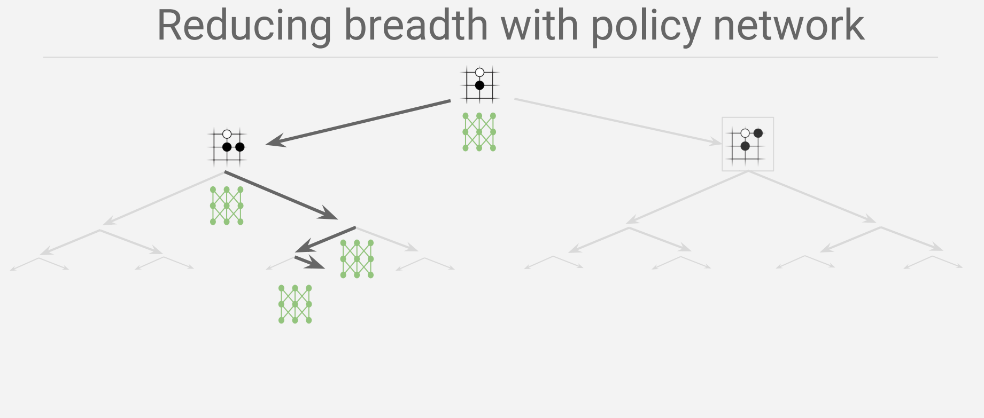
Policy network (CNN) was trained to predict human moves

Slide 174
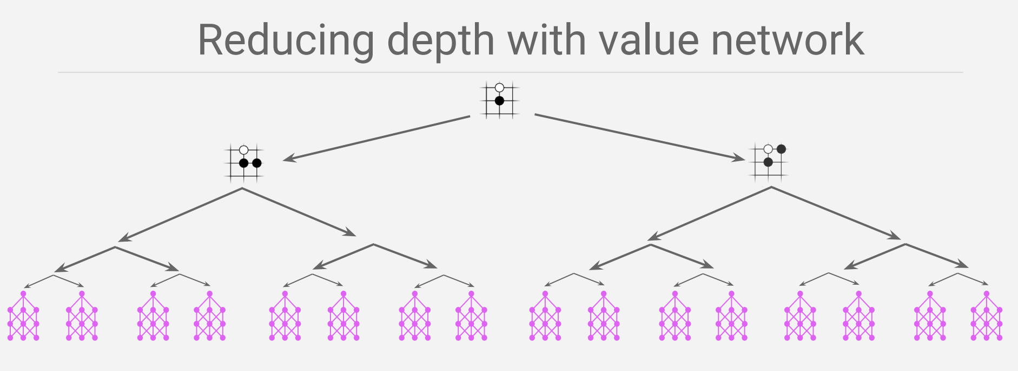
Value network (CNN) was trained to predict reward of each state.

Slide 175
Lecture 10 Genetic Algorithm
CS 180 – Intelligent Systems
Dr. Victor Chen
Fall 2022

Slide 176
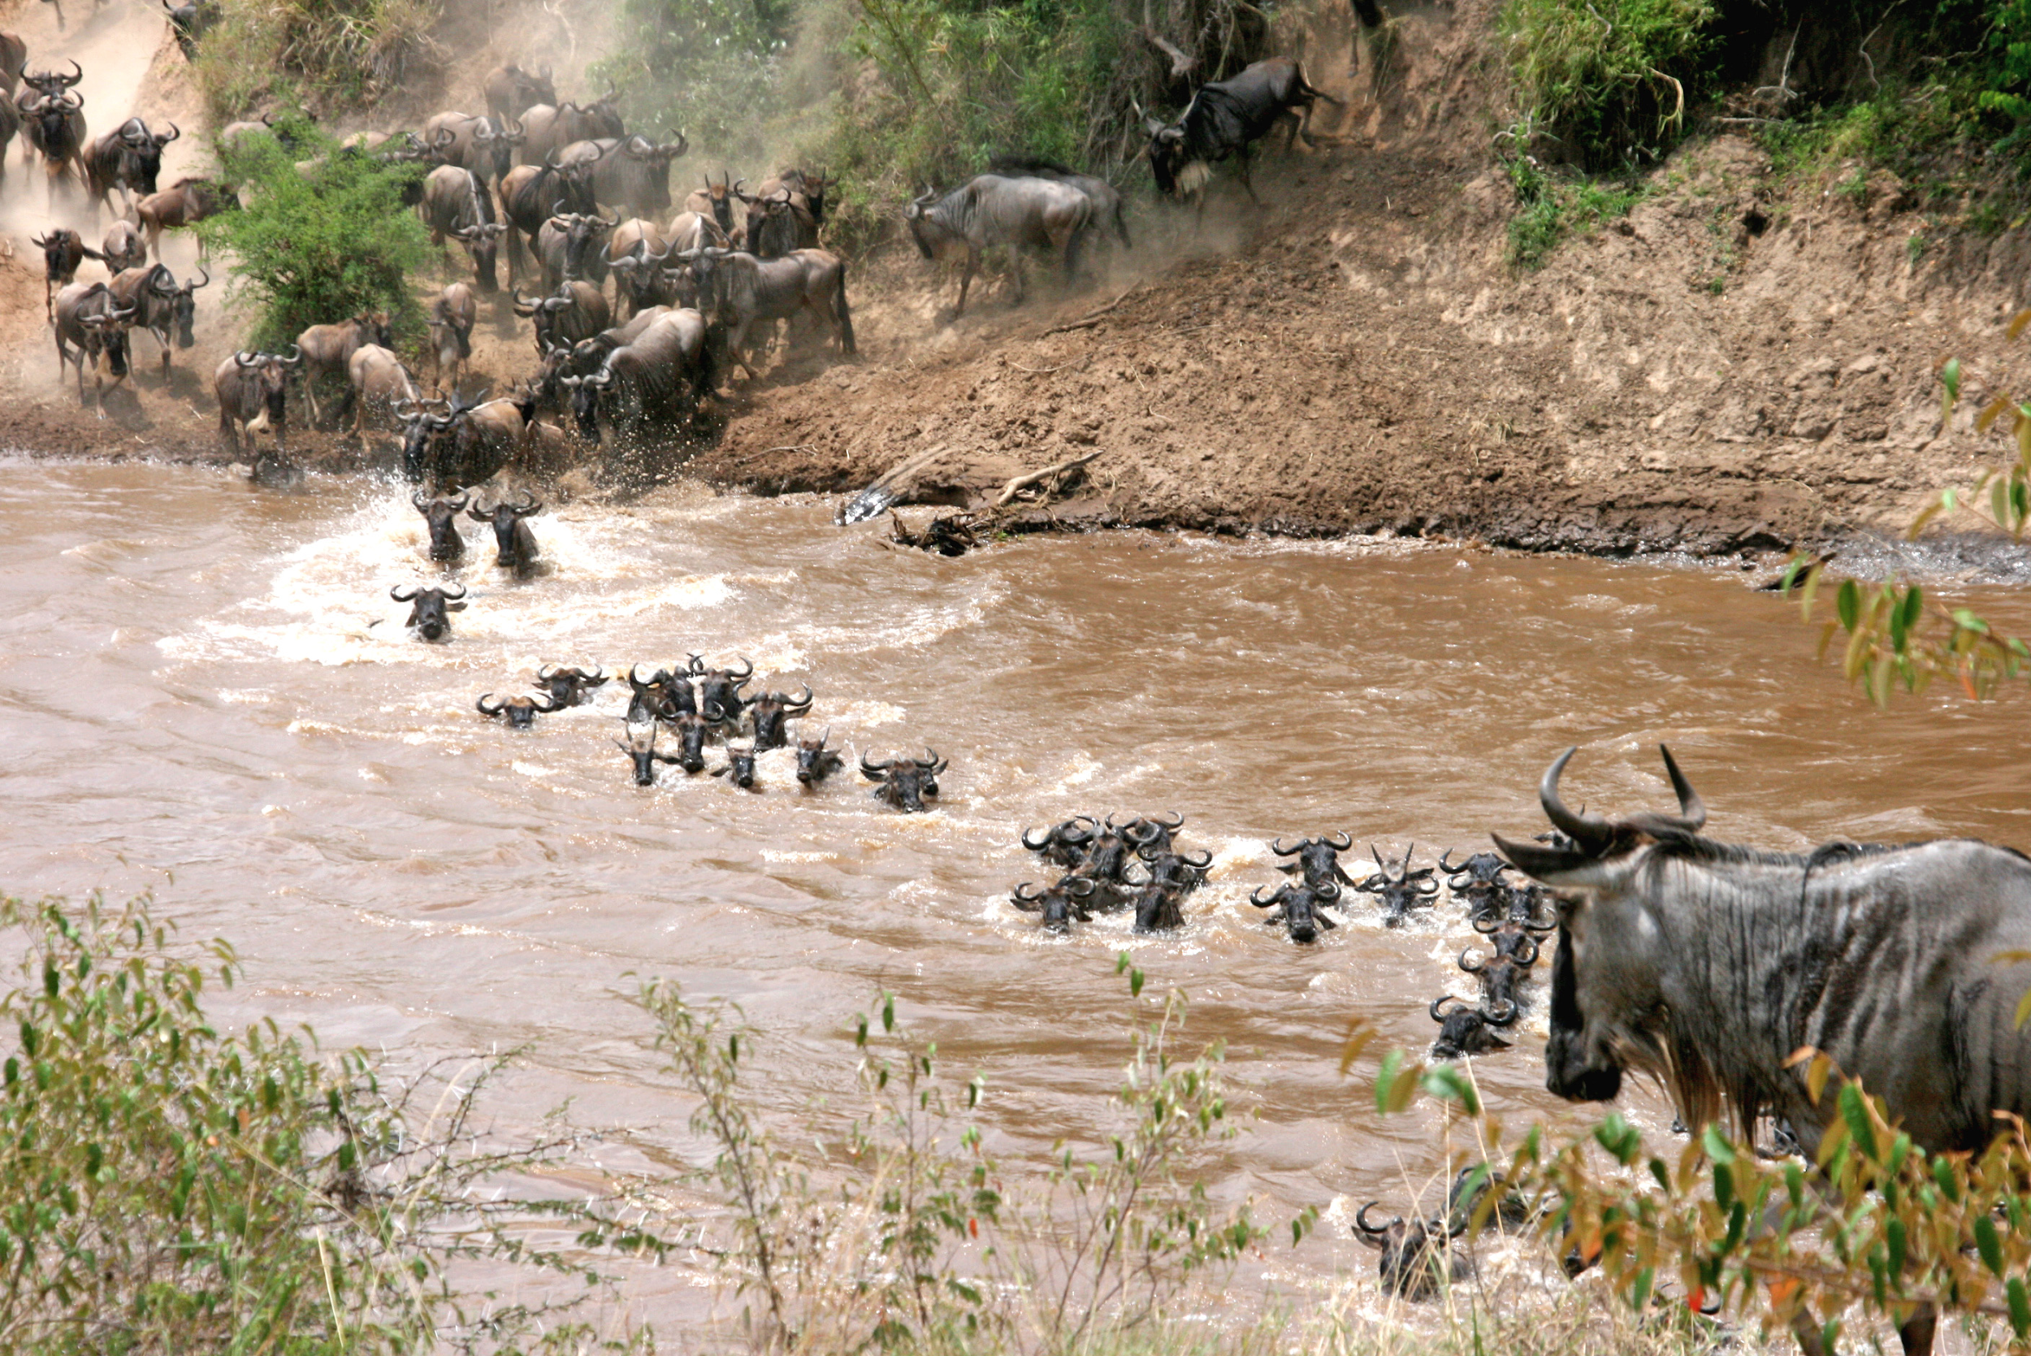
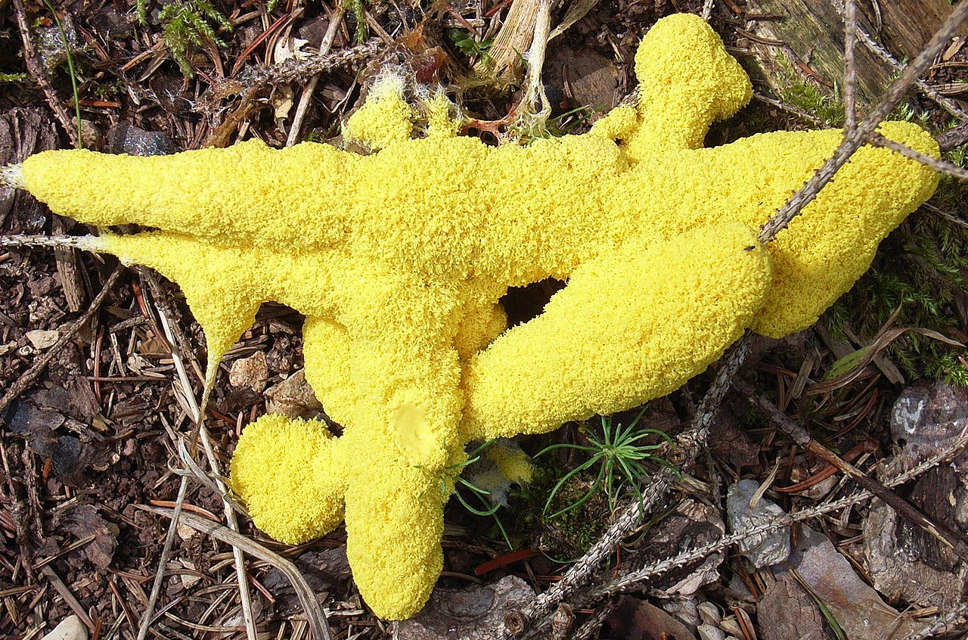
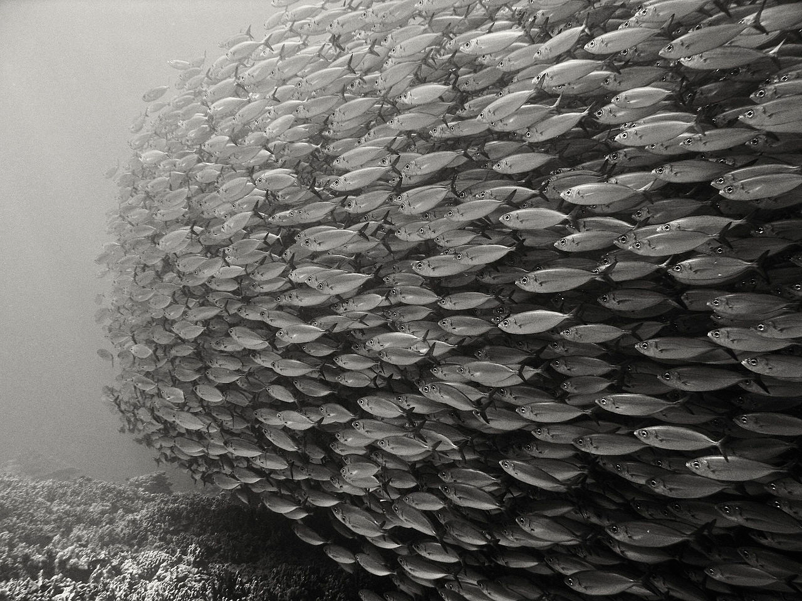

Nature-inspired algorithms
Genetic Algorithm (GA)
Particle Swarm Optimization (PSO)
Ant Colony Optimization (ACO)
Artificial Bee Colony (ABC).
Bird Swarm Algorithm (BSA)

Slide 177

Genetic Algorithm

Slide 178

Intuition of GA
You are head of a country, and in order to keep your city safe from bad things, you implement a policy like this:
You select all the good people, and ask them to extend their generation by having their children.
This repeats for a few generations.
You will notice that now you have an entire population of good people.

Slide 179
An Overview Of GA
GA creates a “population”, or to say, a “group” of possible solutions to the given problem and lets them “evolve” over multiple generations to find better and better solutions.

Slide 180

Applications

Slide 181

When GA Meets Super Mario

Slide 182

Basic Terminology
Population − It is a subset of possible (encoded) solutions.
Chromosome (individual) − A chromosome (individual) is one possible solution
Gene − A gene is one element position of a chromosome.
Allele − It is the value a gene takes.

Slide 183




Think about possible solution representations (encoding)
Binary Representation (bit strings)
Real Valued Representation
Integer Representation
Permutation Representation (each solution is an ordering of elements)
E.g., Travelling salesman problem (TSP)

Slide 184

Basic Structure of Genetic Algorithm
Two possible GA models
Steady State GA: We generate one or two off-springs in each iteration and they will replace one or two individuals from the current population.
Generational GA: We generate ‘n’ off-springs, where n is the population size, and the entire population will be replaced by those new ones at the end of each iteration.

Slide 185


Population Initialization
Populate the initial population with random individuals.

Slide 186

Fitness Function
The fitness function measures the goodness value of the individual
The fitness function should be sufficiently fast to compute

Slide 187
Parent Selection
Select parents who are allowed to create their off-springs
for the next generation.
Three methods:
1. Fitness Proportionate Selection
2. K-Way Tournament Selection
3. Rank Selection

Slide 188
Fitness Proportionate Selection
Fitness Proportionate Selection: Every individual can become a parent with a probability which is proportional to its fitness.
Two implementations:
Roulette Wheel Selection
Stochastic Universal Sampling (SUS)

Slide 189

Roulette Wheel Selection
The wheel is divided into n pies, where n is the number of individuals in the population (population size).
Each individual gets a portion of the circle which is proportional to its fitness value.
Just one fixed point. The region which comes in front of the fixed point is chosen as the parent.
For the second parent, the same process is repeated.

Slide 190

Stochastic Universal Sampling (SUS)
The wheel has N equally spaced fixed points
Therefore, all N parents are chosen in just one spin of the wheel

Slide 191

K-Way Tournament Selection
We select K individuals from the population at random and select the best out of these to become a parent.
The same process is repeated for selecting the next parent.

Slide 192

Rank Selection
Every individual in the population is ranked according to their fitness.
The selection of the parents depends on the rank of each individual rather than the fitness.
The higher ranked individuals are preferred more than the lower ranked ones.

Slide 193
Crossover (exploitation)
Random crossover point(s) are selected and segments are swapped to get new off-springs.
1 point cross-over
1 | 0 | 1 | 0 | 0 | 1 | 0 | 0
0 | 0 | 1 | 1 | 0 | 1 | 1 | 1
P₁
1 | 0 | 1 | 1 | 0 | 1 | 1 | 1
D₁
P₂
0 | 0 | 1 | 0 | 0 | 1 | 0 | 0
D₂
2-points cross-over
1 | 0 | 1 | 0 | 0 | 1 | 0 | 0
0 | 0 | 1 | 1 | 0 | 1 | 1 | 1
P₁
1 | 0 | 1 | 0 | 0 | 1 | 1 | 0
D₁
P₂
0 | 0 | 1 | 1 | 0 | 1 | 0 | 1
D₂

Slide 194

Crossover (exploitation)
Uniform Crossover: We treat each gene separately. We flip a coin for each gene to decide whether it’ll be swapped or not in the off-springs based on heads-up or heads-down.

Slide 195

Arithmetic Recombination Crossover
This is commonly for integer/real representations by taking the weighted average of the two parents :
Child1 = α.x + (1-α).y
Child2 = α.y + (1-α).x
Obviously, if α = 0.5, then both the children will be identical.

Slide 196

Mutation (exploration)
Bit Flip Mutation
select one or more random bits and flip them. This is used for binary encoded GAs.
Swap Mutation
select two random positions on the chromosome, and interchange the values

Slide 197

Mutation
Scramble Mutation
a subset of genes is chosen and their values are shuffled randomly.

Slide 198
Survivor Selection
Steady State GA vs Generational GA
Determines which individuals are to be kicked out from the next generation.
The idea here is to ensure that the fitter individuals are not kicked out, while at the same time diversity should be maintained in the population
Age Based Selection
Fitness Based Selection

Slide 199

Age Based Selection
Each individual is allowed in the population for a finite generation. After that, it is kicked out of the population no matter how good its fitness is.
No fitness used

Slide 200

Fitness Based Selection
The children replace the least fit individuals in the population.

Slide 201
Termination Condition
The above process repeats until some termination conditions are reached
When we reach an certain number of generations.
When the objective function value has reached a certain pre-defined value.

Slide 202
GA Example 1
FUNCTION MAXIMIZATION
Determine the variables that produce the maximum value for this function:

Slide 203
Questions that need to be answered to use GA
How is an individual represented?
How is an individual’s fitness calculated?
How are individuals selected for mating?
How are individuals crossed-over?
How are individuals mutated?

Slide 204
1. How is an individual represented?
Choose a binary sequence for each variable, and then concatenate the four values together into a single bit string.
1101 0110 0111 1100
represents a solution where w = 13, x = 6, y = 7, and z = 12.

Slide 205

2. How is an individual’s fitness calculated?
Assume we have a population of 4 individuals:

Slide 206

3. How are individuals selected for mating?
Suppose we use rank selection where individuals are ranked according to their fitness.
the first individual a 40% chance of being selected
the second a 20% chance
the third a 30% chance
the fourth a 10% chance
Clearly this is giving the better individuals more chances to be selected.

Slide 207

4. How are individuals crossed-over?
Suppose we use 2-points cross-over
Assume that the 1st and 3rd individuals are selected this time.
1010 1110 1000 0011
0110 1001 1111 0110
0111 0110 1110 1011
0001 0110 1000 0000
The 4th and 14th bits are randomly selected to define the substring to be swapped, so the cross-over looks like this:
Thus, two new individuals are created.

Slide 208
Suppose we use generational-GA:
We generate ‘n’ off-springs, where n is the population size, and the entire population is replaced by the new one at the end of the iteration.
We should keep creating new individuals until we have created enough to replace the entire population.

Slide 209

Assume that the 1st and 4th individuals are selected this time.
Note that an individual may be selected multiple times for breeding, while other individuals might never be selected.
Further assume that the 11th and 16th bits are randomly selected for the cross-over point.
We would see a second cross-over like this:
So, we have four new offsprings:
1011 0110 1110 1011
0110 1110 1000 0011
1010 1110 1000 0000
0001 0110 1000 0011

Slide 210

5. How are individuals mutated?
The selected policy: Allow every single bit a small chance to mutate.
Best practice: setting the mutate probability so that roughly 1 bit per individual will change on average.
The mutation will have the bit “flip” – 1 to 0 and 0 to 1.

Slide 211

Wrapping Up: We get 2-nd generation

Slide 212

GA Example 2
Knapsack Problem

Slide 213


Slide 214


Slide 215


Slide 216



Slide 217


Slide 218


Slide 219


1

Slide 220


Slide 221


Slide 222

Practical issues to consider when using GA

Slide 223
Representation (encoding) affect solution quality
Binary Representation (bit strings)
Real Valued Representation
Integer Representation
Permutation Representation (each solution is an ordering of elements)

Slide 224


Revisiting Binary Representations
0111 = 7 but 0011 = 3 !
A small change in one bit may have a massive effect on the solution.

Slide 225

Gray coding (any two successive values differ in only one bit )

Slide 226
In-class practice
What is the grey coding for decimal numbers 10 and 15, respectively?

Slide 227

Real-valued representation
Real-valued representation has no hamming cliffs issue
Any binary arithmetic operator can be used as crossover
For example, “average”

Slide 228


Real-valued representation

Slide 229
GA troubleshooting
Individual representation can largely affect the quality of the solution returned by GA. So if you decide to use GA, you should think about the best way to encode solutions for a given problem.
Try a few different crossover and mutate operators for a given problem.
If your selected crossover and mutate operators may generate “invalid offsprings”, you may assign those “invalid offsprings” a high penalty in the fitness function so that they can be excluded from the next generation automatically.

Slide 230

Famous 8-queen problem
The 8 queens puzzle is the problem of placing eight chess queens on an 8 × 8 chessboard so that no two queens attack each other

Slide 231
Famous 8-queen problem
How should we encode each chessboard as a chromosome, i.e., what would be the best way to create the numeric representation for each chessboard?
You will work on that in Project 4

Slide 232

GA versus NN

Slide 233
Advantages of GAs
Does not require any derivative information (failure of gradient based methods).
Optimizes both continuous and discrete functions and also multi-objective problems.
Provide near-optimal solutions in a short amount of time
Provides a list of “good” solutions and not just a single solution.
Useful when the search space is very large and there are a large number of parameters involved.

Slide 234
Limitations of GAs
GAs are not suited for all problems where derivative information is available.
Fitness value is calculated repeatedly which might be computationally expensive for some problems.
Being stochastic, there are no guarantees on the optimality or the quality of the solution.

Slide 235

GA implementation
https://github.com/DEAP/deap

Slide 236


DEAP installation

Slide 237

Bioinspired Robotics: Smarter, Softer, Safer
https://www.youtube.com/watch?v=RuLAn3XpYAU&t=184s

Slide 238

Biomimicry design
The world is poorly designed. But copying nature helps.
https://www.youtube.com/watch?v=iMtXqTmfta0

Slide 239
Lecture 11 Bayesian Inference
CS 180 – Intelligent Systems
Dr. Victor Chen
Fall 2022

Slide 240

Review on Probability Theory

Slide 241
Random variables
We use random variables to describe uncertain state. Random variables take on values in a domain.
R: Is it raining?
R in {True, False}
W: What’s the weather?
W in {Sunny, Cloudy, Rainy, Snow}
D: What is the outcome of rolling two dice?
D in {(1,1), (1,2), … (6,6)}
S: What is the speed of my car (in MPH)?
S in [0, 200]

Slide 242
Events
Event: a complete assignment of values to all random variables
E.g., if two Boolean variables Cavity and Toothache,
Then there are four distinct events:
Cavity = false ∧Toothache = false Cavity = false ∧ Toothache = true Cavity = true ∧ Toothache = false Cavity = true ∧ Toothache = true

Slide 243
Joint probability
A joint probability P(X₁ = x₁, X₂ = x₂, …, X_{n} = x_{n}) refers to the probability of an event.
The joint probabilities of all the events must sum to 1
Atomic events | P
Cavity = false ∧Toothache = false | 0.8
Cavity = false ∧ Toothache = true | 0.1
Cavity = true ∧ Toothache = false | 0.05
Cavity = true ∧ Toothache = true | 0.05

Slide 244
Marginal (prior) probability
If you sum the joints of all events where X = x, you get the marginal (prior) probability P(X = x)

Slide 245
Derive marginal from joint
P(Cavity, Toothache)
Cavity = false ∧Toothache = false | 0.8
Cavity = false ∧ Toothache = true | 0.1
Cavity = true ∧ Toothache = false | 0.05
Cavity = true ∧ Toothache = true | 0.05
P(Cavity)
Cavity = false | ?
Cavity = true | ?
P(Toothache)
Toothache = false | ?
Toochache = true | ?

Slide 246
Derive marginal from joint
P(Cavity, Toothache)
Cavity = false ∧Toothache = false | 0.8
Cavity = false ∧ Toothache = true | 0.1
Cavity = true ∧ Toothache = false | 0.05
Cavity = true ∧ Toothache = true | 0.05
P(Cavity)
Cavity = false | 0.9
Cavity = true | 0.1
P(Toothache)
Toothache = false | 0.85
Toochache = true | 0.15

Slide 247
Conditional probability (likelihood)
For any two events A and B,
P(A ∧ B)
P(A)
P(B)

Slide 248
Derive conditional from joint
P(Cavity, Toothache)
Cavity = false ∧Toothache = false | 0.8
Cavity = false ∧ Toothache = true | 0.1
Cavity = true ∧ Toothache = false | 0.05
Cavity = true ∧ Toothache = true | 0.05
P(Cavity)
Cavity = false | 0.9
Cavity = true | 0.1
P(Toothache)
Toothache = false | 0.85
Toothache = true | 0.15
What is P(Cavity = true | Toothache = false)?
P(Cavity = true ∧ Toothache = false)/P(Toothache = false) = 0.05 / 0.85 = 0.059
What is P(Cavity = false | Toothache = true)?
P(Cavity = false ∧ Toothache = true)/P(Toothache = true) = 0.1 / 0.15 = 0.667

Slide 249
Derive conditional from joint
P(Cavity, Toothache)
Cavity = false ∧Toothache = false | 0.8
Cavity = false ∧ Toothache = true | 0.1
Cavity = true ∧ Toothache = false | 0.05
Cavity = true ∧ Toothache = true | 0.05
P(Cavity | Toothache = true)
Cavity = false | 0.667
Cavity = true | 0.333
P(Cavity| Toothache = false)
Cavity = false | 0.941
Cavity = true | 0.059
P(Toothache | Cavity = true)
Toothache= false | 0.5
Toothache = true | 0.5
P(Toothache | Cavity = false)
Toothache= false | 0.889
Toothache = true | 0.111

Slide 250

Derive joint from conditional
Chain rule:

Slide 251
Independence
Two events A and B are independent iff P(A, B) = P(A) P(B)
In other words, P(A | B) = P(A) or P(B | A) = P(B)
Conditional independence: A and B are conditionally independent given C iff P(A, B | C) = P(A | C) P(B | C)
Equivalently: P(A | B, C) = P(A | C) or P(B | A, C) = P(B | C)

Slide 252
Conditional independence: Example
Toothache: if the patient has a toothache
Cavity: if the patient has a cavity
Catch: if the dentist’s probe catches in the cavity
If the patient has a cavity, the probability that the probe catches in it doesn't depend on whether she has a toothache
P(Catch | Toothache, Cavity) = P(Catch | Cavity)
Therefore, Catch and Toothache are conditionally independent given Cavity
Question: are Catch and Toothache independent?
No since P(Catch, Toothache) ≠ P(Catch ) P(Toothache)

Slide 253
Use conditional independence to simplify joint calculation
According to the chain rule:
P(Toothache, Catch, Cavity)
= P(Cavity) P(Catch | Cavity) P(Toothache | Catch, Cavity)
if conditional independence:
= P(Cavity) P(Catch | Cavity) P(Toothache | Cavity)
use conditional independence to estimate the joint in an easy way

Slide 254

Bayesian inference
A inference tool that uses conditional independence to simplify the calculation of joint probabilities.

Slide 255


Bayes Rule
Why is this useful?
Posterior is proportional to likelihood × prior
P(A) is the prior and P(A|B) is the posterior
P(B|A) is the likelihood
P(B) is the marginal
Theoretical foundation of Bayesian inference

Slide 256
Bayes Rule example
Marie is getting married tomorrow, at an outdoor ceremony in the desert. In recent years, it has rained only 5 days each year (5/365 = 0.014). Unfortunately, the weatherman has predicted rain for tomorrow. When it actually rains, the weatherman correctly predicts rain 90% of the time. When it doesn't rain, he incorrectly predicts rain 10% of the time. What is the probability that it will rain on Marie's wedding?

Slide 257
Bayes rule: Example
1% of women at age 40 who take routine screening test have breast cancer. 80% of women with breast cancer will get positive test result. 9.6% of women without breast cancer will also get positive test result. Suppose a woman in this age group had a positive test result in a routine screening. What is the probability that she actually has breast cancer?

Slide 258

Bayesian inference
Before we move on to Bayesian inference, let’s take on a look at what inference is.

Slide 259




Inference problem
Given the value of some evidence variable E = e, find the value x of query variable X that maximize the posterior probability:
Examples:
e = image features, X = {tiger, monkey, zebra},

Slide 260







Bayesian inference (apply Bayes rule )
P(E=e) is constant, so we have
If we have multiple evidences (features) E₁, …, E_{n} :
If we assume that E₁, …, E_{n} are conditionally independent :
Here we reduce the inference problem to the problem of estimating likelihood and priors

Slide 261
Case study: Text document classification
Inference: assign a document to the class with the highest posterior P(class | document)
Question: What are evidence variable and query variable?
Goal: estimate likelihoods P(document | class) and priors P(class)
Likelihood: bag of words model
The document is a sequence of words (w₁, …, w_{n})
The order of the words in the document is not important
Each word is independent of the others given document class
Can be computes as:
Product of the likelihoods of individual words

Slide 262
Parameter estimation
How do we obtain likelihoods of individual words?
We need training data of labeled documents
Naïve approach:
Any problem?
# of occurrences of this word in this class
P(word | class) =
total # of words in this class

Slide 263
Parameter estimation
If training data is not very large, the above method may not work very well.
We need to make sure likelihoods are not zero or too small.
Solution: Smoothing:
Used to make sure likelihoods are not zero or too small.
Laplace smoothing: mixing true likelihood in training data with uninform distribution
# of occurrences of this word in this class + 1
P(word | class) =
total # of words in class + V
(V: total number of unique words)

Slide 264
Example (Politics or Sports?)
new doc:
X = “Obama likes basketball”
Training set
Politics
Sports
“Obama meets Merkel”
“Obama elected again”
“Merkel visits Greece again”
“OSFP European basketball champion”
“Miami NBA basketball champion”
“Greece basketball coach?”
P(p) = 0.5
P(s) = 0.5
terms
obama:2, meets:1, merkel:2, elected:1, again:2, visits:1, greece:1
OSFP:1, european:1, basketball:3, champion:2, miami:1, nba:1, greece:1, coach:1
Total # of terms: 10
Total # of terms: 11
Vocabulary (distinct terms) size: 14

Slide 265



Example (Politics or Sports?)
For a document $d$with k terms $d=(t_{1},…, t_{k})$, the posterior of class $c$ is:
$$P\left(c | d\right)=P\left(c\right)P(d|c)=P(c)\prod_{t_{i}∈d}{P(t_{i}|c)}$$
$$P\left(t_{i} | c\right)= \frac{N_{ic}+1}{N_{c}+V}$$
Number of times $t_{i}$ appears in all docs belonging to c
Laplace Smoothing
Likelihood of $t_{i}$ in c
Total number of unique words
(vocabulary size)
Total number of terms in all docs
belonging to c

Slide 266
Example (Politics or Sports?)
Politics
Sports
Documents in training
“Obama meets Merkel”
“Obama elected again”
“Merkel visits Greece again”
“OSFP European basketball champion”
“Miami NBA basketball champion”
“Greece basketball coach?”
P(p) = 0.5
P(s) = 0.5
terms
obama:2, meets:1, merkel:2, elected:1, again:2, visits:1, greece:1
OSFP:1, european:1, basketball:3, champion:2, miami:1, nba:1, greece:1, coach:1
Vocabulary size: 14
Total # of terms: : 10
Total # of terms: 11
new doc:
X = “Obama likes basketball”
P(Politics|X) = P(p)*P(obama|p)*P(likes|p)*P(basketball|p)
= 0.5 * (2+1)/(10+14) *(0+1)/(10+14) * (0+1)/(10+14) = 0.000108
P(Sports|X) = P(s)*P(obama|s)*P(likes|s)*P(basketball|s)
= 0.5 * (0+1)/(11+14) *(0+1)/(11+14) * (3+1)/(11+14) = 0.000128

Slide 267
Lecture 12 Fuzzy Logic and Expert Systems
CS 180 – Intelligent Systems
Dr. Victor Chen
Fall 2022

Slide 268

Three AI areas
Knowledge Learning
Machine learning/Neural networks
No closed-form math expression
Optimization
Search
Adversarial search
Genetic algorithms
Knowledge Reasoning
Bayesian inference
Fuzzy logic

Slide 269

What is a FUZZY LOGIC?
Fuzzy Logic is an approach to computing based on “degrees of truth” rather than the usual “true or false” (1 or 0) boolean (binary) logic, on which the modern computers are based.

Slide 270


DNA match/search using fuzzy Logic
To find approximate matches for a search key

Slide 271



Text match/search using fuzzy Logic
To find approximate matches (slang, misspelling, abbreviation on social media) for a search key

Slide 272
Other fuzzy logic applications
To match customers to identify the buying behavior
For customer address matching
To match file paths
To detect plagiarism (text re-use)
For spam filtering

Slide 273
Fuzzy Sets (Fuzzy Logic) vs Crisp Sets (Boolean Logic)
Crisp Set → Classical sets which have distinct objects. For e.g.,
A = {apples, oranges, mangoes}
B = {2, 4, 6, 8}
(each element has a membership degree of 1)
Fuzzy Set → The membership degree can be 0<μ(x) < 1
A = { 0.4 + 0.6 + 0.7 }
train
car
cycle
where is a separator, and ＋ is the logic OR
train has a membership degree of 0.4
If the membership degree is 0, it means that the element is not associated with set A.
If the membership degree is 1, it means that the element is strongly associated with set A.
Notes:
Fuzzy Logic is so important in real world scenario because most of the scenarios do not have distinct values, but are based on approximation. For e.g., the no. of RBC in your blood cannot be actually counted, but we can always have an estimated value. Or, the growth of bacteria in a particular environment can only be predicted but we cannot have the correct value.
Fuzzy logic operates on the concept of membership and the degrees of membership, which ranges from 0 to 1.

Slide 274
FUZZY THEORY
Boolean Logic (Crisp Sets)
Is Bob honest?
Fuzzy Logic (Fuzzy Sets)
True
(1)
False
(0)
Is Bob honest?
Very honest
Honest
Honest (sometimes)
dishonest
(1)
(0.8)
(0.5)
Membership value
μ_{A} (x) = 1, iif x ε A
= 0, iif x ε A
(0)
(membership value/degree)
Membership value
μ_{A} (x) ε [0, 1]

Slide 275
Definition of Fuzzy Sets
A fuzzy set A is defined by using
A={ x |μ(x)}
where μ(x) is a membership function.
The range of μ(x) is [0,1]. We cannot say clearly if x is in A or not when 0<μ(x) < 1.
A fuzzy set A is described as follows:
A = μ_{A}(x₁)/x₁+ μ_{A}(x₂)/x₂+…+ μ_{A}(x_{N})/x_{N}
where / is a separator, and ＋ is the logic OR.

Slide 276
Operations on fuzzy sets
Meaning | Set notation | Membership function
Equivalence | A = B | μ_{A} (x) = μ_{B} (x)
Implication | A ⊆ B | μ_{A} (x) ≤ μ_{B} (x)
Complement (negation) | A | μ (x) = 1− μ (x) _{A} A
Union | A∪ B | μ_{A∪B} (x) = max{μ_{A} (x), μ_{B} (x)}
Intersection | A∩ B | μ_{A∩B} (x) = min{ μ_{A} (x), μ_{B} (x)}

Slide 277

Operations of fuzzy sets
Meaning | Set notation | Membership function
Difference | A − B or (A∩B) | μ_{A-B} (x) = min{ μ_{A} (x), ¬μ_{B} (x)}
Sum | A + B | μ_{A+B} (x) = μ_{A} (x) +μ_{B} (x) –(μ_{A} (x) ⋅ μ_{B} (x))
Product | A ⋅ B | μ (x) = μ_{A} (x) ⋅ μ_{B} (x) _{A}⋅ _{B}
Bounded sum | A⊕ B | μ_{A}⊕_{B} (x) = min{1, μ_{A} (x) + μ_{B} (x)}
Bounded difference | A B | μ_{A B} (x) = max{ 0 , μ_{A} (x) –μ_{B} (x)}

Slide 278

Union

Slide 279

Intersection

Slide 280

Complement

Slide 281

Difference

Slide 282

Sum

Slide 283

Product

Slide 284

Bounded Sum

Slide 285

Bounded Difference

Slide 286
Practice
All the people: X={Alice, Bob, Charles, Eric, William}
Fuzzy sets A=“young persons” and B=“tall persons” are defined by
A = 0.4/Alice + 0.6/Bob + 0.8/Charles +1.0/Eric + 0.9/William
B = 0.3/ Alice + 0.5/Bob +0.9/Charles + 0.6/Eric + 1.0/William
Who are the young or tall persons?
A∪B = 0.4/Alice + 0.6/Bob + 0.9/Charles + 1.0/Eric + 1.0/William
Who are the young and tall persons?
A∩B =0.3/ Alice +0.5/Bob +0.8/ Charles + 0.6/ Eric + 0.9/William
Who are tall and old persons?
B − A = B ∩ A
A = 0.6/Alice + 0.4/Bob + 0.2/Charles +0/Eric + 0.1/William
B − A = 0.3/Alice + 0.4/Bob + 0.2/Charles +0/Eric + 0.1/William

Slide 287
Fuzzy Numbers
Fuzzy numbers are fuzzy sets defined on real numbers
Given A = μ_{A}(x₁)/x₁+ μ_{A}(x₂)/x₂+…+ μ_{A}(x_{N})/x_{N} , if x_{1,} x_{2, …} x_{N} are real numbers and 0< μ_{A}(x_{i}) < 1, the A is a fuzzy number.
On the other hand, if for any x_{N} , μ(x_{N}) = 0 or 1, then A is a crisp number or crisp set

Slide 288

One example fuzzy number

Slide 289


fuzzy numbers vs crisp numbers

Slide 290

Cases of fuzzy numbers
Membership functions of fuzzy numbers can be unsymmetric
large number small number

Slide 291

Two fuzzy numbers (each X has a membership value for each fuzzy number)

Slide 292

Intersection of fuzzy numbers

Slide 293

Union of fuzzy numbers

Slide 294

Negation (Complement) of fuzzy number

Slide 295


In Artificial Intelligence, the ultimate question is:
MACHINES THINK LIKE HUMAN
Humans think and reason in a way similar to fuzzy logic/numbers

Slide 296

Expert Systems and Fuzzy inference
An expert system is an AI that solves problems by reasoning. An expert system has two components: a knowledge base and an inference engine
Most of the inference engines used in experts systems were built on fuzzy inference techniques
The most used fuzzy inference technique is the so-called Mamdani method.

Slide 297
Fuzzy inference (Mamdani method)
The fuzzy inference process is performed in four steps:
Fuzzification of the input variables,
Evaluation of fuzzy rules (i.e., rules on fuzzy numbers);
Aggregation of the rule outputs
Defuzzification.

Slide 298
Operation of Fuzzy System
Crisp Input
Fuzzification
Input Membership Functions
Fuzzy Input
Rule Evaluation
Fuzzy rules
Rule Output Aggregation
Fuzzy Output
Defuzzification
Output Membership Functions
Crisp Output

Slide 299
Two (crisp) input variables:
X is on a scale of 0 to 10, described using three fuzzy numbers:
A1 : project_funding is inadequate
A2: project_funding is marginal
A3: project_funding is adequate
Y is on a scale of 0 to 10, described using two fuzzy numbers:
B1: project_staffing is small
B2: project_staffing is large
Output (crisp) variable: Z = ? Z is on a scale of 0 to 100
C1: risk is low
C2: risk is normal
C3: risk is high

Slide 300
Step 1: Let’s define fuzzy numbers
A1 : project_funding is inadequate
A2: project_funding is marginal
A3: project_funding is adequate
B1: project_staffing is small
B2: project_staffing is large
C1: risk is low
C2: risk is normal
C3: risk is high

Slide 301
Step 2: Let’s define fuzzy rules on fuzzy numbers:
Rule: 1 Rule: 1
IF x is A3 IF project_funding is adequate
OR y is B1 OR project_staffing is small
THEN z is C1 THEN risk is low
Rule: 2 Rule: 2
IF x is A2 IF project_funding is marginal
AND y is B2 AND project_staffing is large
THEN z is C2 THEN risk is normal
Rule: 3 Rule: 3
IF x is A1 IF project_funding is inadequate
THEN z is C3 THEN risk is high

Slide 302
Step 3: Fuzzification
Take the crisp inputs, X and Y (project funding and project staffing)
Determine the degree to which these inputs belong to each fuzzy number.
The output is called fuzzy input

Slide 303
Suppose X (project funding) = 3 and Y (project staffing) = 6
project funding
project staffing
Fuzzy input: μ_{(x=A1)} = 0.5 μ_{(x=A2)} = 0.2 and μ_{(x=A3)} = 0 , μ_{(y=B1)} = 0.1 and μ_{(y=B2)} = 0.7

Slide 304
Step 4: Rule Evaluation
Apply the fuzzy input to the fuzzy rules.
To evaluate the disjunction of the rule inputs, we use the OR fuzzy operation.
μ_{A}∪_{B}(x) = max [μ_{A}(x), μ_{B}(x)]
To evaluate the conjunction of the rule inputs, we apply the AND fuzzy operation :
μ_{A}∩_{B}(x) = min [μ_{A}(x), μ_{B}(x)]

Slide 305
Mamdani-style rule evaluation
Fuzzified inputs:
μ_{(x=A1)} = 0.5
μ_{(x=A2)} = 0.2
μ_{(x=A3)} = 0 ,
μ_{(y=B1)} = 0.1
μ_{(y=B2)} = 0.7
Fuzzy output: z is C1 (0.1), z is C2 (0.2), and z is C3 (0.5),

Slide 306
Step 5: Aggregation of the Rule Outputs
We combine fuzzy outputs into a single fuzzy number.

Slide 307
Step 6: Defuzzification
The defuzzification process converts the aggregated fuzzy number to a single (crisp) number.
In other words, here we convert the fuzzy output to the crisp output for final presentation
Most popular defuzzification method is the centroid defuzzification.

Slide 308
Centroid defuzzification method finds a point representing the center of gravity of the fuzzy number, A, on the interval, ab.
A reasonable estimate can be obtained by calculating weighed sum over a sample of points.

Slide 309
Centre of gravity (COG):

Slide 310
Result
Two input variables:
project_funding = 3, on a scale of 0 to 10
project_staffing = 6, on a scale of 0 to 10
Output :
risk = 67.4 on a scale of 0 to 100

Slide 311

Lab: Implementing Fuzzy Control Systems using Fuzzy Inference
Scikit-fuzzy
Tipping problem

Slide 312

Install Scikit-fuzzy

